Slide 1
Make a copy or download so you can edit for your chapter.
Please delete any slides for activities you did not complete.

Slide 2

2025 - 2026
Peak Awards Submission Instructions
Each item in the Peak Award scoresheet has a corresponding task number. Insert the documentation on each slide that corresponds with the scoresheet item.
If not completing a particular item, the slide can be deleted. Instruction slides can also be deleted before submission.
If additional slides are needed, duplicate the slide (making sure the task number in the heading stays the same).
The background can be changed (adding color, etc.), but only the content will be graded.
Submit the completed scoresheet and the slides using the online submission link. Scoresheet must remain in Excel or Google Sheet format.
Make sure sharing options are turned on if sharing via Google. Peak Awards that are not viewable cannot be graded.

Slide 3
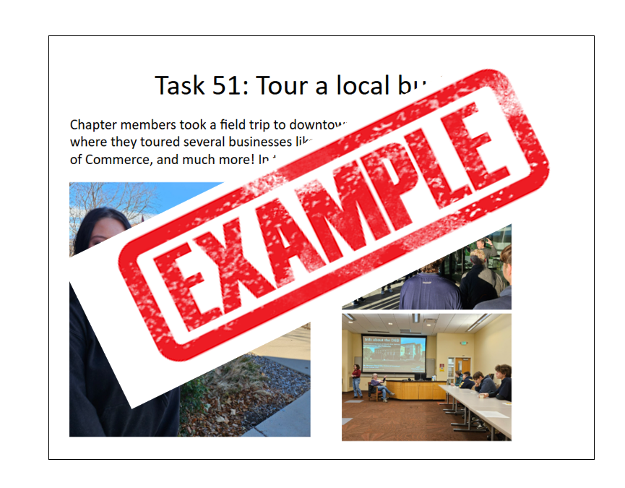

Slide 4
2025 - 2026
Peak Awards Submission
Chapter Name Here

Slide 5
2025 - 2026
Peak Awards Submission
Recruitment & Chapter Kick Off
Recommended to complete August 1 – September 24

Slide 6
Task 1: Completed Program of Work
Insert documentation here – or delete slide if not completing this item

Slide 7
Task 2: Elect chapter officers and hold training
Insert documentation here – or delete slide if not completing this item

Slide 8
Task 3: Community service committee
Insert documentation here – or delete slide if not completing this item

Slide 9
Task 4: Cards/emails to members over the summer
Insert documentation here – or delete slide if not completing this item

Slide 10
Task 5: List of at least 5 potential sponsors
Insert documentation here – or delete slide if not completing this item

Slide 11
Task 6: Communication channel between officers and members
Insert documentation here – or delete slide if not completing this item

Slide 12
Task 7: Chapter t-shirt design (must comply with brand guidelines)
Insert documentation here – or delete slide if not completing this item

Slide 13
Task 8: Informal meet-and-greet
Insert documentation here – or delete slide if not completing this item

Slide 14
Task 9: Letter to invite guest speakers
Insert documentation here – or delete slide if not completing this item

Slide 15
Task 10: Project plan for chapter recruitment
Insert documentation here – or delete slide if not completing this item

Slide 16
Task 11: Chapter budget
Insert documentation here – or delete slide if not completing this item

Slide 17
Task 12: First FBLA meeting of the year
Insert documentation here – or delete slide if not completing this item

Slide 18
Task 13: Printed FBLA calendar for each member
Insert documentation here – or delete slide if not completing this item

Slide 19
Task 14: Proof of membership change
Insert documentation here – or delete slide if not completing this item

Slide 20
Task 15: Reward your top recruiter
Insert documentation here – or delete slide if not completing this item

Slide 21
Task 16: Chapter Bylaws
Insert documentation here – or delete slide if not completing this item

Slide 22
Task 17: Official FBLA Ceremony
Insert documentation here – or delete slide if not completing this item

Slide 23
Task 18: FBLA creed recited at meeting
Insert documentation here – or delete slide if not completing this item

Slide 24
Task 19: Chapter social media plan
Insert documentation here – or delete slide if not completing this item

Slide 25
Task 20: Adviser is a CBAM Board member
Insert documentation here – or delete slide if not completing this item

Slide 26
Task 21: Adviser is a National/Colorado FBLA Board Member
Insert documentation here – or delete slide if not completing this item

Slide 27
Task 22: Adviser is a board member from other CTE organization
Insert documentation here – or delete slide if not completing this item

Slide 28
Task 23: Chapter member is a Colorado State Officer
Insert documentation here – or delete slide if not completing this item

Slide 29
Task 24: Adviser attends Colorado FBLA Adviser Q&A
Insert documentation here – or delete slide if not completing this item

Slide 30
Task 25: Adviser attends 2025 CACTE
Insert documentation here – or delete slide if not completing this item

Slide 31
Task 26: Adviser attends 2025 CBAM
Insert documentation here – or delete slide if not completing this item

Slide 32
Task 27: Champion Chapter – Summer Starter
Insert documentation here – or delete slide if not completing this item

Slide 33
2025 - 2026
Peak Awards Submission
Membership Retention
Recommended to complete September 25 – November 5

Slide 34
Task 28: Submit membership for 10 paid members
Insert documentation here – or delete slide if not completing this item

Slide 35
Task 29: Create a Member of the Month program
Insert documentation here – or delete slide if not completing this item

Slide 36
Task 30: Plan a “buddy” activity
Insert documentation here – or delete slide if not completing this item

Slide 37
Task 31: Organize a special outing for FBLA members
Insert documentation here – or delete slide if not completing this item

Slide 38
Task 32: Host an FBLA spirit day
Insert documentation here – or delete slide if not completing this item

Slide 39
Task 33: Guest speaker at chapter meeting
Insert documentation here – or delete slide if not completing this item

Slide 40
Task 34: Send a letter to a sponsor
Insert documentation here – or delete slide if not completing this item

Slide 41
Task 35: Plan a community service event
Insert documentation here – or delete slide if not completing this item

Slide 42
Task 36: Meet with your officers to review POW
Insert documentation here – or delete slide if not completing this item

Slide 43
Task 37: Review the Competitive Events Guidelines & create sign-up sheet
Insert documentation here – or delete slide if not completing this item

Slide 44
Task 38: 1-minute elevator speech
Insert documentation here – or delete slide if not completing this item

Slide 45
Task 39: Plan a chapter fundraiser
Insert documentation here – or delete slide if not completing this item

Slide 46
Task 40: Set up a recruitment booth
Insert documentation here – or delete slide if not completing this item

Slide 47
Task 41: Actively use member point system
Insert documentation here – or delete slide if not completing this item

Slide 48
Task 42: Host an FBLA event for parents
Insert documentation here – or delete slide if not completing this item

Slide 49
Task 43: Participate in State Officer Financial Literacy social media challenge
Insert documentation here – or delete slide if not completing this item

Slide 50
Task 44: Active social media account following Colorado FBLA
Insert documentation here – or delete slide if not completing this item

Slide 51
Task 45: Other chapter Public Relations activities
Insert documentation here – or delete slide if not completing this item

Slide 52
Task 46: Champion Chapter – Shaping Success submission
Insert documentation here – or delete slide if not completing this item

Slide 53
2025 - 2026
Peak Awards Submission
Service & Engagement
Recommended to complete November 6 – January 7

Slide 54
Task 47: American Enterprise Day project
Insert documentation here – or delete slide if not completing this item

Slide 55
Task 48: Thank You cards to group of your choice
Insert documentation here – or delete slide if not completing this item

Slide 56
Task 49: Lead a community service event
Insert documentation here – or delete slide if not completing this item

Slide 57
Task 50: 10 hours of community service
Insert documentation here – or delete slide if not completing this item

Slide 58
Task 51: Tour a local business
Insert documentation here – or delete slide if not completing this item

Slide 59
Task 52: Host a competitive events study/prep event
Insert documentation here – or delete slide if not completing this item

Slide 60
Task 53: Participate in a critical needs drive
Insert documentation here – or delete slide if not completing this item

Slide 61
Task 54: Workshop about servant leadership to an FBLA middle school chapter
Insert documentation here – or delete slide if not completing this item

Slide 62
Task 55: Thank sponsors for their contributions
Insert documentation here – or delete slide if not completing this item

Slide 63
Task 56: Upload a resource developed for your chapter
Insert documentation here – or delete slide if not completing this item

Slide 64
Task 57: Student volunteer to assist chapter adviser with chapter management
Insert documentation here – or delete slide if not completing this item

Slide 65
Task 58: Register a chapter Alzheimer’s Team
Insert documentation here – or delete slide if not completing this item

Slide 66
Task 59: Submit to Service Sunday form
Insert documentation here – or delete slide if not completing this item

Slide 67
Task 60: Submit a Service Sunday that aligns with themed challenge
Insert documentation here – or delete slide if not completing this item

Slide 68
Task 61: Participate in a Fundraising Frenzy challenge
Insert documentation here – or delete slide if not completing this item

Slide 69
Task 62: Create social media post relating to “FBLA Amplified” challenge
Insert documentation here – or delete slide if not completing this item

Slide 70
Task 63: Host awareness activity relating to “FBLA Amplified” challenge
Insert documentation here – or delete slide if not completing this item

Slide 71
Task 64: Host service event relating to “FBLA Amplified” challenge
Insert documentation here – or delete slide if not completing this item

Slide 72
Task 65: Activity with a Colorado Collegiate FBLA chapter
Insert documentation here – or delete slide if not completing this item

Slide 73
Task 66: Attend Monthly Membership Meeting
Insert documentation here – or delete slide if not completing this item

Slide 74
Task 67: FBLA night at a Colorado sports team
Insert documentation here – or delete slide if not completing this item

Slide 75
Task 68: Recruit a new chapter
Insert documentation here – or delete slide if not completing this item

Slide 76
Task 69: Chapter post to social media with Colorado FBLA tagged
Insert documentation here – or delete slide if not completing this item

Slide 77
Task 70: Chapter website
Insert documentation here – or delete slide if not completing this item

Slide 78
Task 71: Submission to Peak Leaderboard
Insert documentation here – or delete slide if not completing this item

Slide 79
Task 72: Other Membership Activities
Insert documentation here – or delete slide if not completing this item

Slide 80
Task 73: Champion Chapter – Service Season submission
Insert documentation here – or delete slide if not completing this item

Slide 81
2025 - 2026
Peak Awards Submission
Chapter Excellence
Recommended to complete January 1 – March 4

Slide 82
Task 74: Review FBLA Week Toolkit and plan at least two events
Insert documentation here – or delete slide if not completing this item

Slide 83
Task 75: Visual item posted to demonstrate importance of CTE
Insert documentation here – or delete slide if not completing this item

Slide 84
Task 76: FBLA Week Proclamation
Insert documentation here – or delete slide if not completing this item

Slide 85
Task 77: Deliver report about a chapter community service project
Insert documentation here – or delete slide if not completing this item

Slide 86
Task 78: Watch National President’s Forum
Insert documentation here – or delete slide if not completing this item

Slide 87
Task 79: Plan a social event during FBLA Week
Insert documentation here – or delete slide if not completing this item

Slide 88
Task 80: Share an FBLA story on Instagram
Insert documentation here – or delete slide if not completing this item

Slide 89
Task 81: Sponsor a Teacher Appreciation Day
Insert documentation here – or delete slide if not completing this item

Slide 90
Task 82: School Board presentation about CTE and FBLA
Insert documentation here – or delete slide if not completing this item

Slide 91
Task 83: Memo to school administrators about competitors going to conferences
Insert documentation here – or delete slide if not completing this item

Slide 92
Task 84: Ask an FBLA collegiate member to join meeting and talk about college experience
Insert documentation here – or delete slide if not completing this item

Slide 93
Task 85: Request a state or national officer visit
Insert documentation here – or delete slide if not completing this item

Slide 94
Task 86: Raise at least $100 for the FBLA Week Alzheimer’s Fundraiser
Insert documentation here – or delete slide if not completing this item

Slide 95
Task 87: Participate in CTE Month
Insert documentation here – or delete slide if not completing this item

Slide 96
Task 88: Attend District Leadership Conference
Insert documentation here – or delete slide if not completing this item

Slide 97
Task 89: Recruit a judge or workshop presenter at your DLC
Insert documentation here – or delete slide if not completing this item

Slide 98
Task 90: Chapter member is a District Officer
Insert documentation here – or delete slide if not completing this item

Slide 99
Task 91: Chapter officer presents to business classes
Insert documentation here – or delete slide if not completing this item

Slide 100
Task 92: Present competition materials to non-adviser adults
Insert documentation here – or delete slide if not completing this item

Slide 101
Task 93: Article submitted to CO FBLA Today
Insert documentation here – or delete slide if not completing this item

Slide 102
Task 94: FBLA chapter featured on a form of media the chapter doesn’t run
Insert documentation here – or delete slide if not completing this item

Slide 103
Task 95: Adviser participation in District Grading Day
Insert documentation here – or delete slide if not completing this item

Slide 104
Task 96: Adviser is a member in a CTE organization
Insert documentation here – or delete slide if not completing this item

Slide 105
Task 97: FBLA connected lesson plan
Insert documentation here – or delete slide if not completing this item

Slide 106
Task 98: SLC award submission
Insert documentation here – or delete slide if not completing this item

Slide 107
Task 99: Colorado FBLA scholarship submission
Insert documentation here – or delete slide if not completing this item

Slide 108
Task 100: CBAM scholarship submission
Insert documentation here – or delete slide if not completing this item

Slide 109
Task 101: Awards received at 2025 SLC
Insert documentation here – or delete slide if not completing this item

Slide 110
Task 102: Champion Chapter: CTE Celebration
Insert documentation here – or delete slide if not completing this item

Slide 111
2025 – 2026
Peak Awards Submission
National & State Programs
Must be completed by the Peak Awards submission deadline

Slide 112
Task 103: Connect 10
Insert documentation here – or delete slide if not completing this item

Slide 113
Task 104: Chapter member completes the BAA Contributor, Leader, and/or Advocate
Insert documentation here – or delete slide if not completing this item

Slide 114
Task 105: Chapter member completes the BAA Capstone
Insert documentation here – or delete slide if not completing this item

Slide 115
Task 106: Entry to the #ENDALZ: SA Bound
Insert documentation here – or delete slide if not completing this item

Slide 116
Task 107: Chapter enrolls in Lead4Change
Insert documentation here – or delete slide if not completing this item

Slide 117
Task 108: Stock Market Game participation
Insert documentation here – or delete slide if not completing this item

Slide 118
Task 109: Application to National FBLA scholarship
Insert documentation here – or delete slide if not completing this item

Slide 119
Task 110: Participate in Knowledge Matters VBC or PFC
Insert documentation here – or delete slide if not completing this item

Slide 120
Task 111: Flyer to promote the BAAs
Insert documentation here – or delete slide if not completing this item

Slide 121
Task 112: Attend National Fall Leadership Conference or Colorado Fall Leadership Conference
Insert documentation here – or delete slide if not completing this item

Slide 122
Task 113: Invite middle school graduates to meeting
Insert documentation here – or delete slide if not completing this item

Slide 123
Task 114: Conduct a survey of your members
Insert documentation here – or delete slide if not completing this item

Slide 124
Task 115: Donate at least $50 to National Scholarship Fund
Insert documentation here – or delete slide if not completing this item

Slide 125
Task 116: Participate in LifeSmarts Challenge
Insert documentation here – or delete slide if not completing this item

Slide 126
Task 171: Attended 2025 NLC
Insert documentation here – or delete slide if not completing this item

Slide 127
Task 118: Attended 2025 SLC
Insert documentation here – or delete slide if not completing this item

Slide 128
Task 119: Recruit a judge or workshop presenter for the 2026 SLC
Insert documentation here – or delete slide if not completing this item

Slide 129
Task 120: Student participation in Job Shadow or Career Fair
Insert documentation here – or delete slide if not completing this item

Slide 130
Task 121: Other Chapter Professional Development activities
Insert documentation here – or delete slide if not completing this item

Slide 131
Task 122: Member applies to Colorado Selection Committee or as a State Officer Candidate
Insert documentation here – or delete slide if not completing this item

Slide 132
Task 123: End of Year Banquet
Insert documentation here – or delete slide if not completing this item

Slide 133
Task 124: Other Chapter Social Activities
Insert documentation here – or delete slide if not completing this item

Slide 134
Task 125: Collaboration with another CTSO
Insert documentation here – or delete slide if not completing this item

Slide 135
Task 126: Contribute to national charity
Insert documentation here – or delete slide if not completing this item

Slide 136
Task 127: Contribute to Colorado Relief Fund
Insert documentation here – or delete slide if not completing this item

Slide 137
Task 128: Contribute to Colorado Scholarship Fund
Insert documentation here – or delete slide if not completing this item

Slide 138
Task 129: Business sponsorship to CO FBLA
Insert documentation here – or delete slide if not completing this item

Slide 139
Task 130: Pin or T-shirt Design Contest entry
Insert documentation here – or delete slide if not completing this item

Slide 140
Task 131: Champion Chapter – Champion + submission (from 2025)
Insert documentation here – or delete slide if not completing this item

