Slide 1
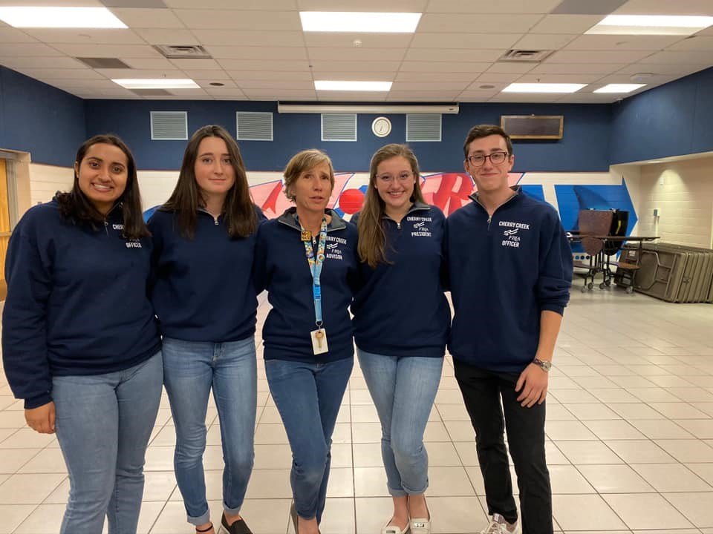







Chapter Management 101:
Basic Steps for Running an Outstanding Chapter

Slide 2
Where Do You Fit In?
National Center
State Advisers
Local Advisers
Local Officers
Members
National
National Leadership Conference and National Fall Leadership Conference
National guidelines and deadlines for national level programs and competitions
State
State Leadership Conference
Local
Chapter activities
Local Officer Campaigns and Voting
State guidelines and deadlines for local chapter
Chapter recruitment, membership dues collection
Chapter fundraising
Point of contact for national-level information, guidelines, and deadlines
Chapter Management Handbook resource
Membership dues processing
Notes:
As you manage your FBLA chapter, you’ll work closely with your officers, your members, and your administration. You’ll also work with your state adviser and the National Center.
As a local adviser you are a manager, mentor, advocate, and role model for your local officers and the FBLA members in your chapter.
This graphic details some of the activities that you’ll cover at the various levels.
FBLA-PBL is organized on local, state, and national levels. The national center is headquartered in Reston, Virginia (just outside of D.C.). As a local adviser, you will spend the majority of your time working on the local level and interacting with your state adviser.

Slide 3
The Many Roles of an Adviser
Notes:
A successful chapter depends on the guidance and support of the local chapter adviser. As an adviser, you are instrumental in organizing and motivating your chapter.
Your roles will include:
Leader – A successful adviser empowers student leaders to discover their talents and strengths.
Marketer – You are the voice and the advocate of FBLA to the students, school administrators, and community.
Networker – Just as networking is an important part of business, it is also pivotal in promoting your chapter and creating professional development opportunities for your students.
Fundraiser – Successful chapters are successful fundraisers. Fundraising is a great way to give your students hands-on learning opportunities in finance, sales, and development.
Coach – FBLA-PBL’s competitive events provide students the opportunity to expand their business skills. Review event guidelines in the competitive events section of the Chapter Management Handbook and integrate standards into your class to begin preparing your students early for competition.
Travel Agent – Start planning now for upcoming FBLA trips. Before you go, communicate with parents and send home written information about conference details. Make sure both students and parents are aware of your standards. After you arrive remind students why they are at a conference or on an FBLA trip and make sure they understand the dress code.

Slide 4
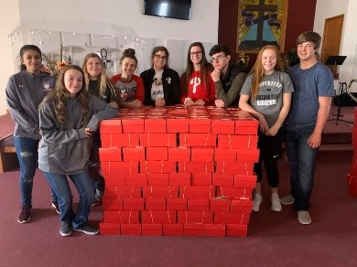
Your Local Chapter
Notes:
Your chapter consists of members, with a local officer team elected by the members. It is your responsibility to engage all of your members and encourage members to apply for office and vote for officers. You may want to meet with local officers before member meetings and delegate tasks to the group.
Throughout your school year, you’ll work closely with your officers, your members, and your administration.

Slide 5
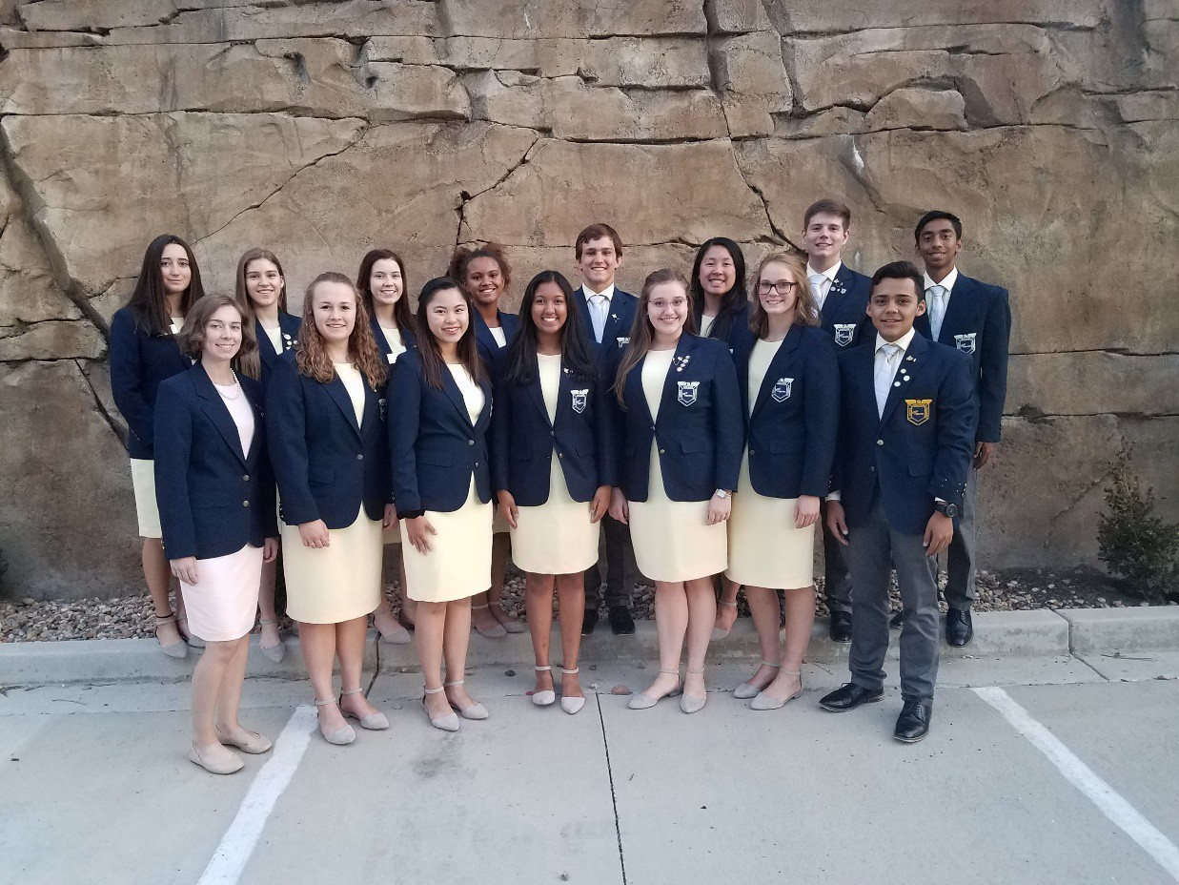
State/District/Local Relationship
State Adviser
District Board Member
District State Officer
District Adviser
Deadlines are determined by District & State Level
Notes:
Your main point of contact is your State Adviser.
State advisers coordinate chapter activities for the national organization and set guidelines/deadlines for local chapters.
In Colorado, FBLA is split into 11 districts. Each district has a Board Member that is a current business teacher and FBLA adviser. Each district should have a student state officer. The student state officer’s adviser is called the District Adviser.
Questions regarding local activities should be directed to the state adviser or district leadership. All local FBLA programs, competitive events, deadlines, and guidelines are dependent on the state adviser.

Slide 6
Adviser Responsibilities
Establish a link between the local
chapter and business community
School board/administration, parents, school, local media
Assist chapter officers in Program of
Work (Calendar of Events) for your chapter
Notes:
Throughout the year, you’ll connect with a broad range of people and groups:
Business and civic community
School boards and administration
Parents
Local media
You’ll also work with your chapter officers to develop a Program of Work (Calendar of Events), which will benefit all members in your chapter.
The success of the chapter rests upon the student members; however, without the guidance of the local chapter adviser, success would not be possible. The local chapter adviser should:
Be knowledgeable about the history, bylaws, and programs of the national organization for the operation of the chapter.
Direct, chaperone, coordinate, and supervise chapter activities.
Organize the selection process for chapter officers and provide officer training.
Encourage civic responsibility.
Assist in the maintenance of necessary chapter records.
Establish rules and guidelines that will help students lead themselves while remaining consistent with school policies and state and national bylaws.
Hold regular chapter meetings and see that they are conducted in a business-like manner.
Assist members and officers in developing an annual program of work which includes a budget, calendar, and committee assignments.
Assist members in planning, collecting, preparing, and arranging materials to promote the chapter and its activities.
Ensure school administration, faculty, students, and the public are informed of chapter activities and outstanding student achievements.
Be knowledgeable of the guidelines for district/regional, state, and national competitive events and activities and coordinate participation at all levels.
Oversee financial development projects and supervise the receipt, recording, depositing, and expenditure of chapter funds.

Slide 7
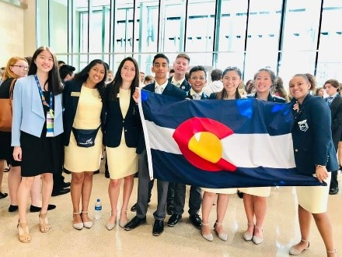

Adviser Responsibilities
Request and supervise field trips,
events, and conferences
Collect dues, record-keeping, finances
Notes:
Connect with your school/district treasurer/bookkeeper on district policies for finances.

Slide 8
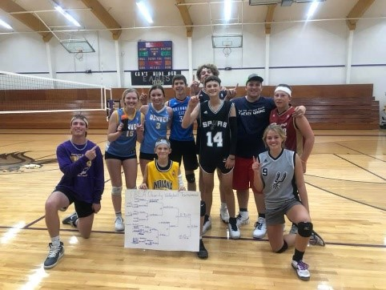
Benefits of Being an Adviser
Professional development
Travel
Networking
Impacting our youth!
Notes:
There are numerous opportunities for professional development, both online and at FBLA-PBL conferences. Both the National Fall Leadership Conferences and the National Leadership Conferences offer workshops specifically for educators on the subjects of national programs, social media, curriculum, finance, accounting, etc.
You have the opportunity to enhance your curriculum by offering students real-life learning and networking opportunities beyond the classroom that can in turn build your class enrollments. Your courses are also validated when students compete against students from other schools.
The biggest benefit is the fact that you’re making a difference and helping students build confidence in their work and themselves.

Slide 9
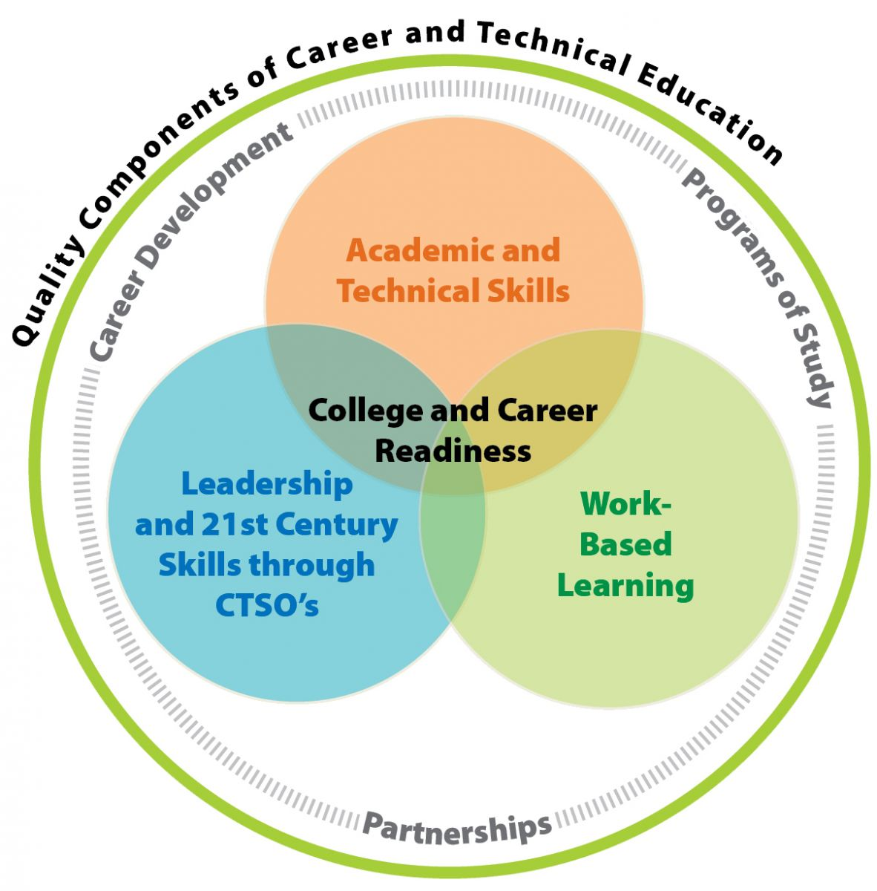
Career & Technical Education (CTE) and
Career & Technical Student Organizations (CTSOs)
Notes:
Career and Technical Education (CTE) teachers student real-life skills. By adding a CTSO, which expands education beyond the classroom, students have many more opportunities to explore career options, get leadership training, and network with other leaders from across the country. FBLA-PBL is one of 10 CTSOs that are preparing students for careers in high-skill jobs.
According to the 2013 My College Options Survey of the national FBLA membership, 52% of students say that FBLA has had a positive impact on their academic performance. In addition 45% noted increased business skills, 40% said they developed leadership skills, 40% responded that FBLA helped build their confidence, and 20% said that the organization helped them develop a career portfolio. 15% more than nonmembers also indicated that they are more likely to attend a four-year university after high school.

Slide 10
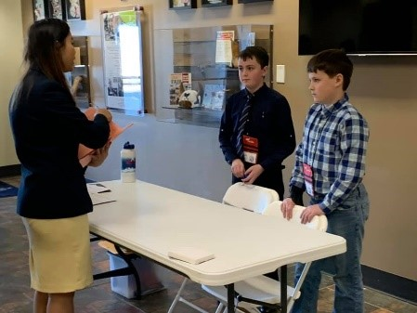
FBLA-PBL Mission
FBLA-PBL inspires and prepares students to become community-minded business leaders in a global society through relevant career preparation and leadership experiences.
Competitive Events
Conferences
National and State Programs
Notes:
FBLA-PBL helps prepare students for college and careers by building confidence, assisting students in the development of occupational goals, and facilitating the transition from school to work.
This is done through the following three areas:
National and State Programs
Competitive Events
Conferences

Slide 11
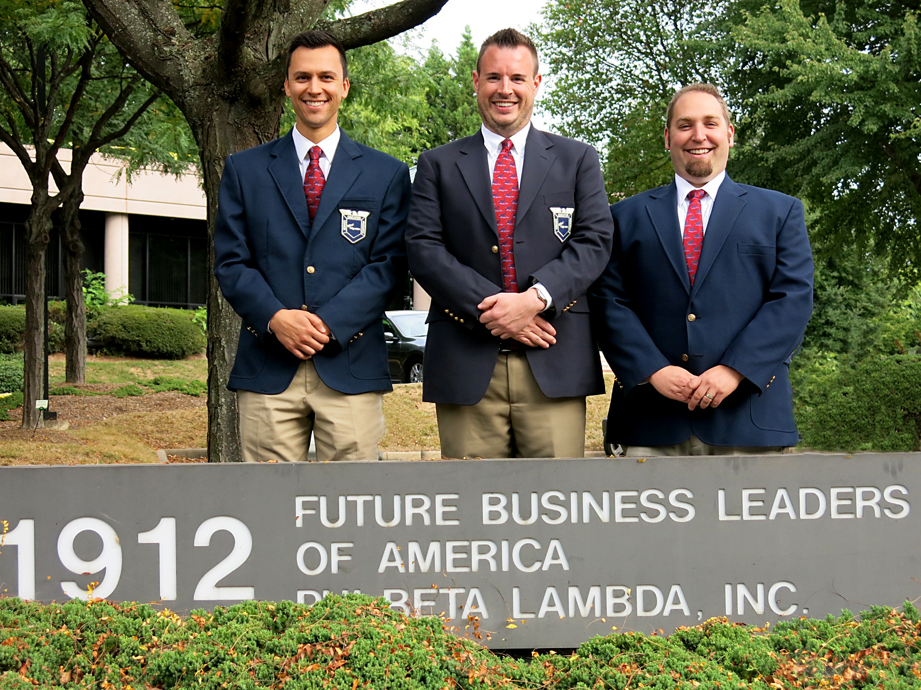
FBLA-PBL Divisions
Divisions
  FBLA (high school level)
  PBL (collegiate level)
  FBLA-Middle Level
  (middle school)
  Professional
Notes:
The FBLA concept was developed by Dr. Hamden L. Forkner in 1937. There are 4 divisions of FBLA-PBL:
FBLA
PBL
FBLA Middle Level
Professional
The first high school chapter was chartered in 1942 in Tennessee. The first collegiate chapter was chartered in 1958 in Iowa. The professional division began in 1979, and the FBLA-Middle Level for students in grades 5-9 started in 1994.

Slide 12
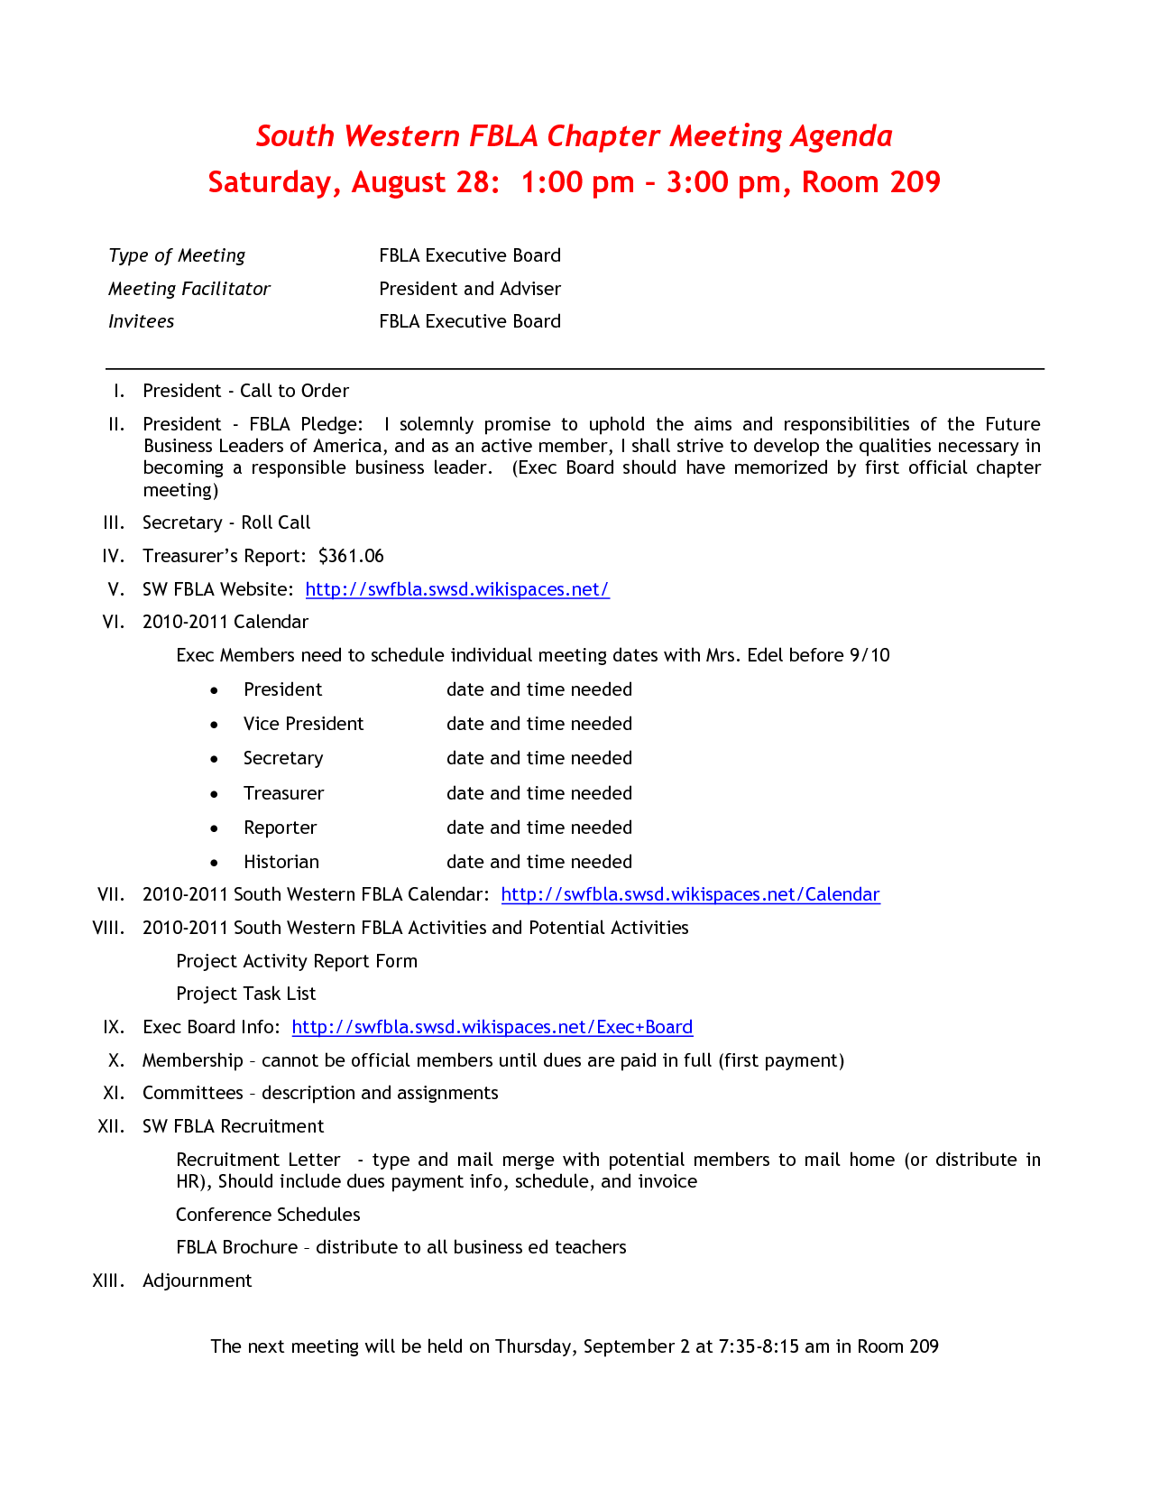
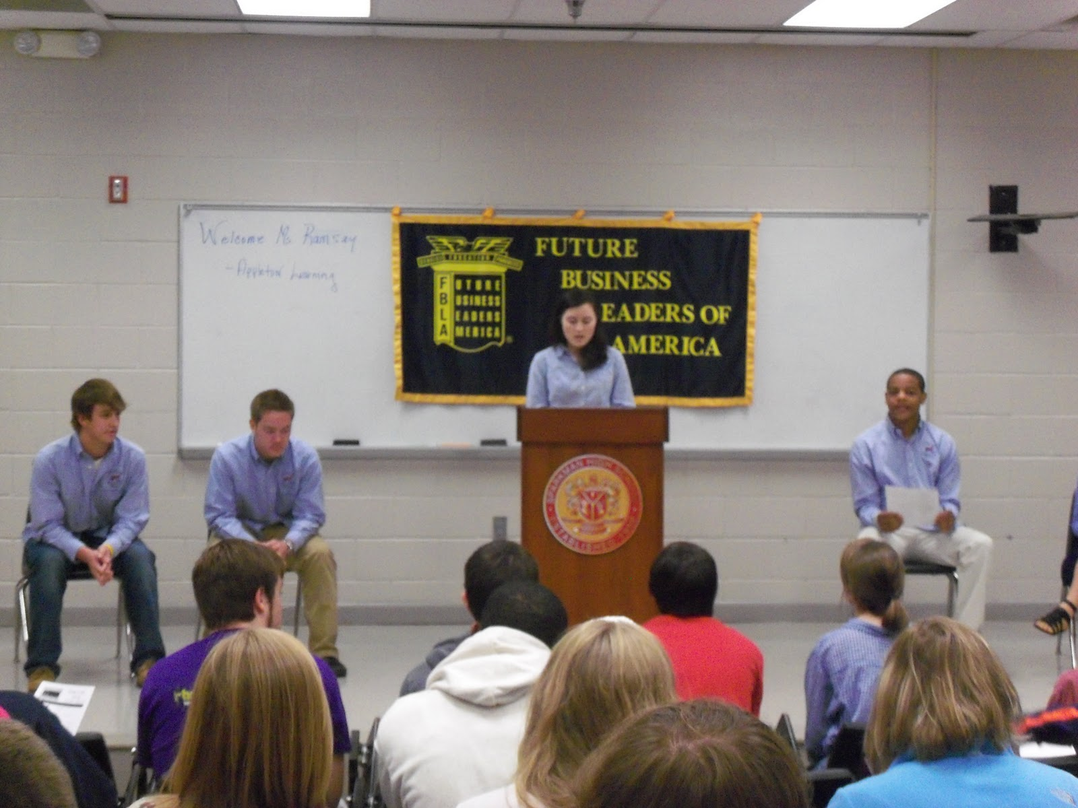
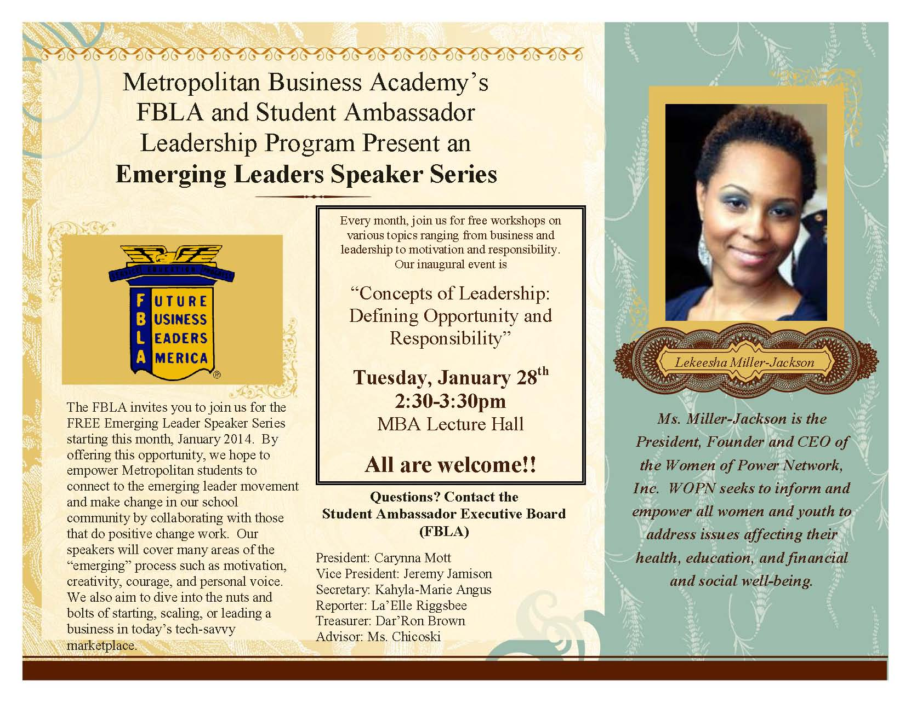
Building Your Chapter
Notes:
The Welcome Guide will be your go-to resource throughout the school year, in addition to your state adviser.
You’ll also need to meet with your school principal on a regular basis, to update him or her on your progress. Plus, it’s a great opportunity to promote all the great things you’re doing in your chapter.
If you have not done so already, elect student officers and create three or four different project committees that students can sign up for.
Once you elect your chapter officers, you’ll want to schedule monthly meetings, at a minimum. Plan meaningful activities and use community leaders as guest speakers. Your officers should run each meeting – you will want to meet with them prior to each scheduled chapter meeting. Work with your officers to plan an agenda. Food helps both for your officer meetings and your regular meetings.
During the meeting you can collect and pay your dues online -- we’ll take a look at how to do that later.
Finally, make sure you integrate FBLA into your classroom to give your students and your members the best experience possible. FBLA programs align both to career clusters and the National Business Education Association Standards (NBEA).

Slide 13
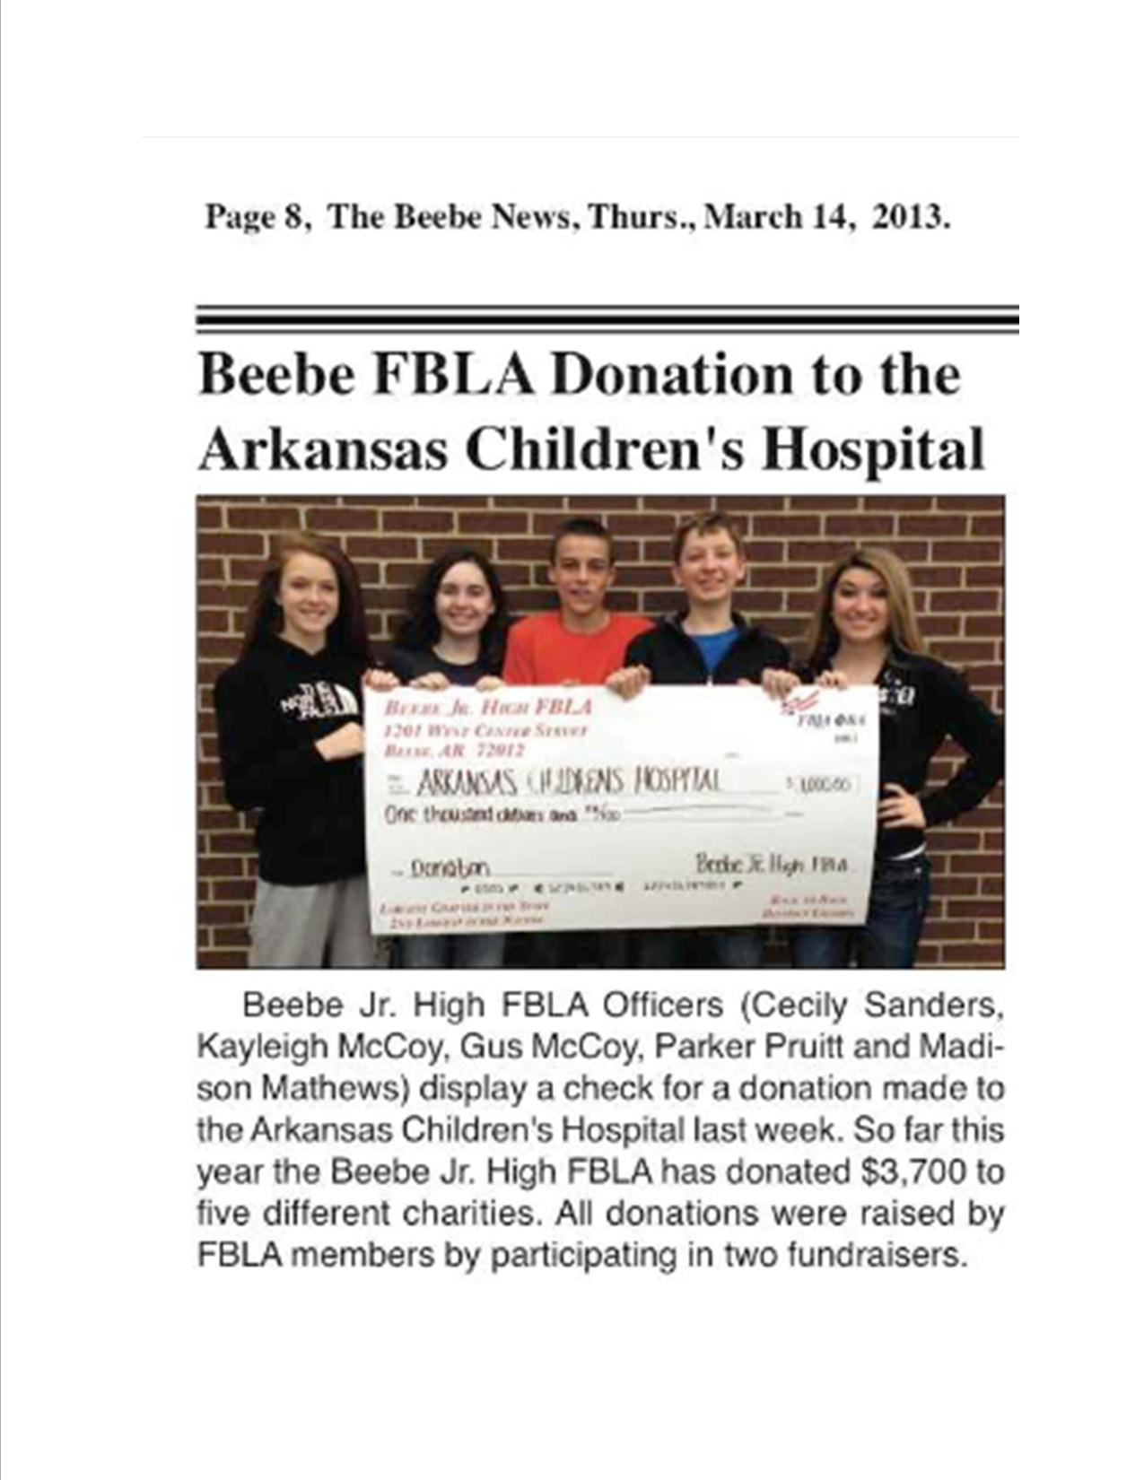
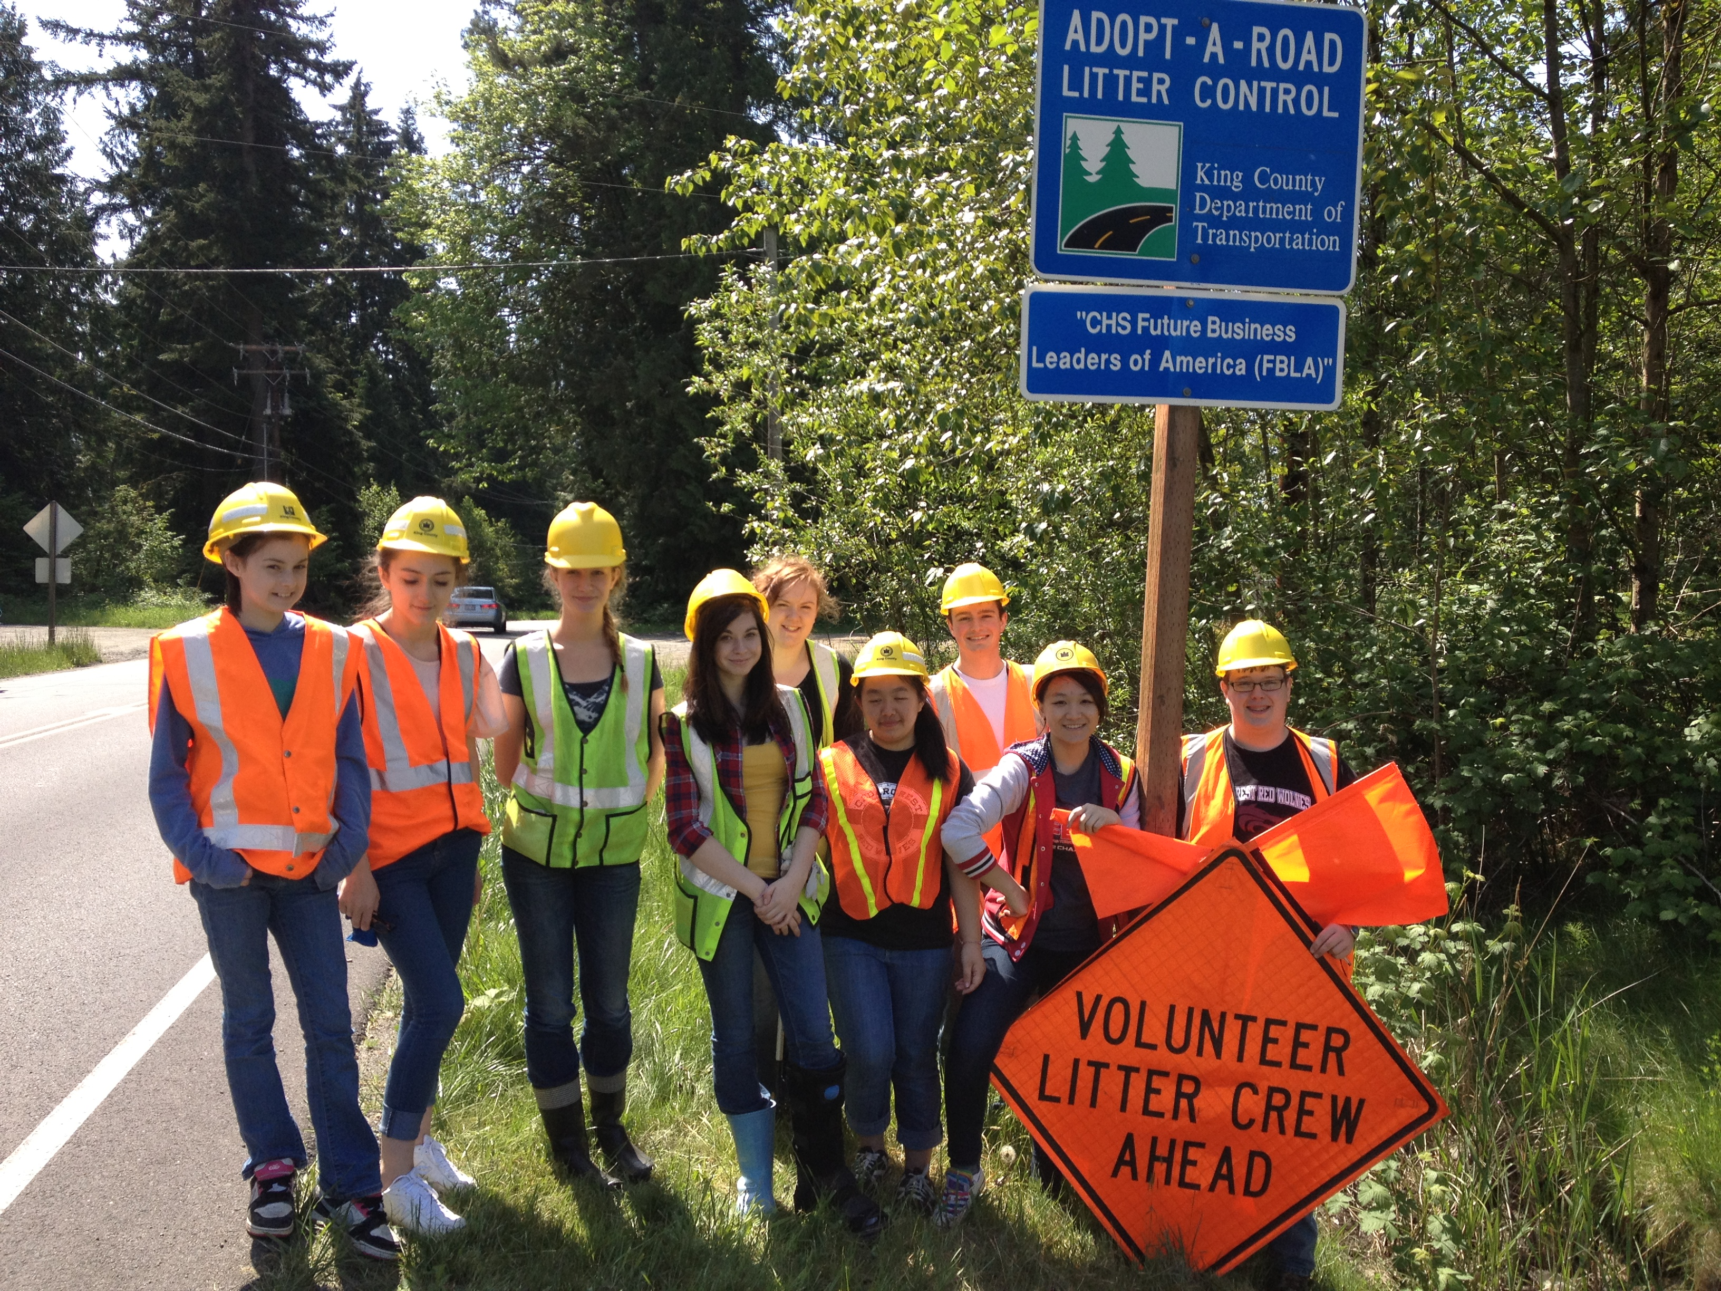
Why Establish Committees?
Delegate responsibility
Promote leadership & creativity among members
Foster teamwork
Encourage service learning
Notes:
When reviewing the list of adviser responsibilities, it might seem a little overwhelming. But remember, you don’t have to do it alone!
By electing officers and establish committees with students service as chairs, you have student leaders to help you out with the day-to-day tasks that will make your chapter a success. Usually the Vice President is an ex-officio member of all committees. Why not delegate some of your duties through these committees such as the promotion of meetings, raising funds, community service activities, etc.
It’s also a great way to encourage your members to take a leadership role and grow as future business leaders. And a nice benefit is the fact that you’ll tap into the creative minds of your best students.
Committees also foster teamwork and community.

Slide 14
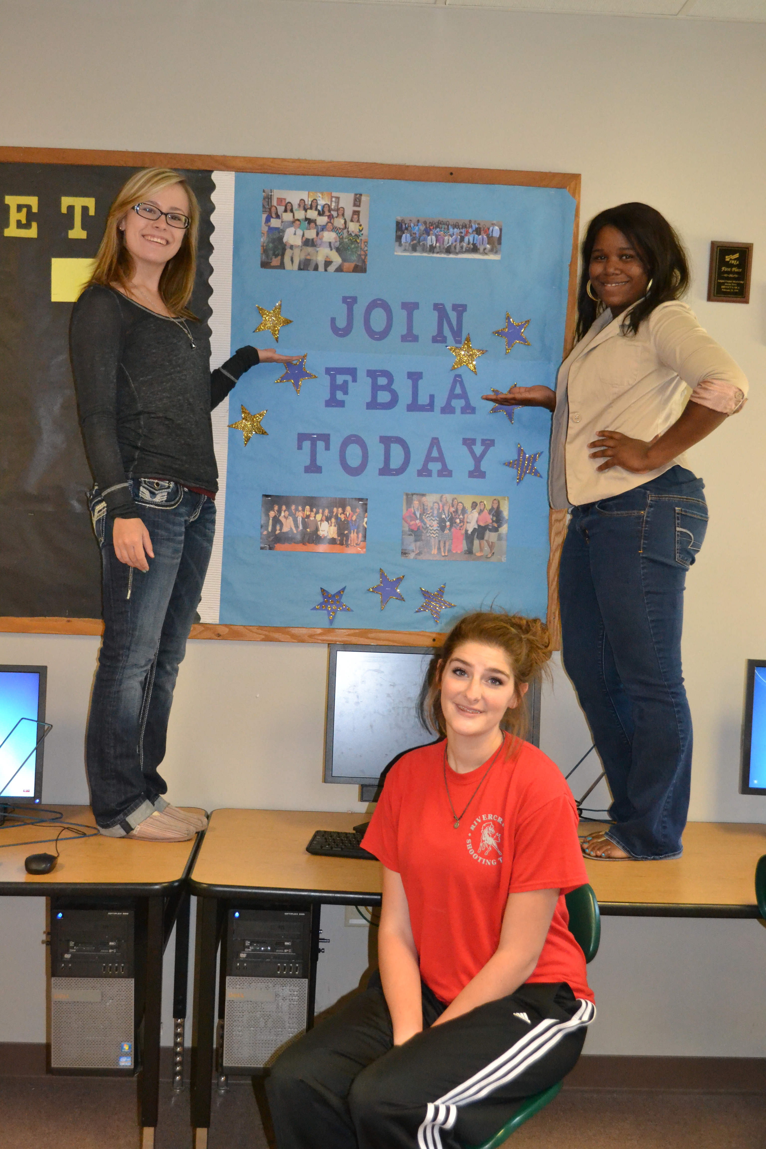
Sample Committees
Recruitment
Social
Financial Leadership
Public Relations
Community Service
Business & Industry
Peak Awards
Notes:
Here are some ideas for member committees that can help ease your workload. The Committee Chair of each committee should complete a project evaluation or report for every project upon its completion.
Recruitment – promotes membership, plans a recruitment and retention strategy, plans a new member induction ceremony, etc.
Fundraising – plans projects to raise money for local chapter activities throughout the year.
Social – plans social events such as welcome back parties, holiday parties, business tours, trips, etc.
Public Relations – spreads the word about FBLA through posters, flyers, bulletin boards, and social media.
Community Service – plans service learning activities for state projects, March of Dimes, the community, etc.

Slide 15
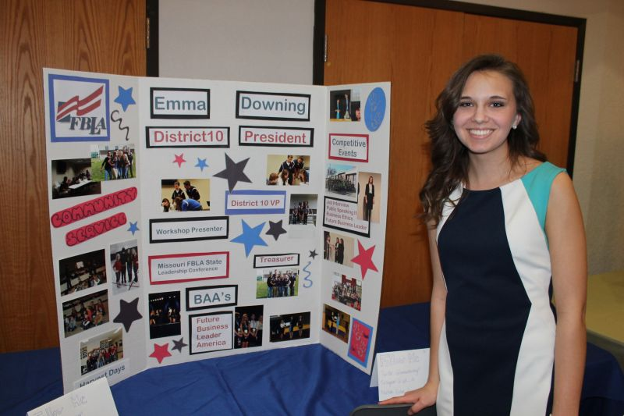
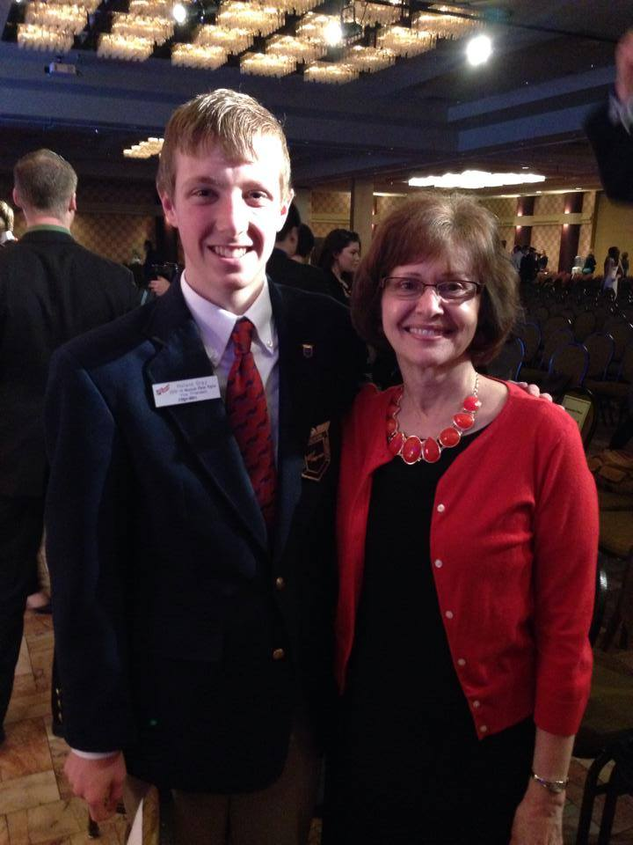
Working with Officers
Types of Officers
  Local Officers
  State Officers
  National Officers
Develop Local Officer training program
Schedule Local Officer meetings before membership meeting
Notes:
Officers can play a big role in your chapter. Many chapters have the following officers positions:
President
Vice President
Secretary
Treasurer
Reporter
Historian
Parliamentarian
Develop a training program so they know their responsibilities. Local officers should be:
Educated about FBLA and understand its purpose, programs, and opportunities available
Understand their duties
Plan all activities and projects well in advance with adviser approval and guidance
Help the president delegate tasks among the officers
Run interesting and well-organized meetings
Be interested in participating in conferences at all levels of the organization
After they’ve received training on different national programs, recruitment and retention, etc., it’s time to delegate a number of your responsibilities to them. Check on their progress monthly and let them know how they are doing.
Don’t forget to have your local officers connect with your state and national officers. The state and national officers will be working on a number of programs to increase recruitment and retention, so you’ll want your local officers to be aligned to your state and national goals.

Slide 16
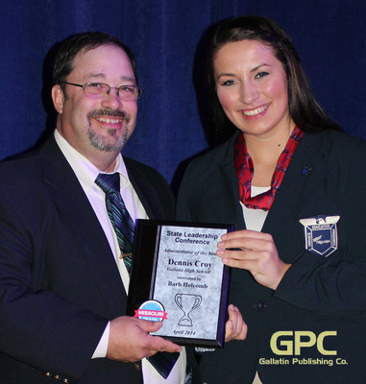
Support from Administration
Meet with principal to communicate activity dates and absentee policy
Invite to open house or emblem ceremony
Invite to the SLC and NLC
Notes:
Your FBLA chapter is one of many activities sponsored by your school. By keeping your school’s officials and administrators involved and aware of your activities, you will show them that your program is valuable to your school. Persuade your administrators to support FBLA by inviting them to special events and functions. Some states, like Missouri, even offer an Administrator of the Year Recognition program.
Send them periodic updates telling them what you have accomplished, how the school and its students and faculty have benefited, and what you are going to do next.

Slide 17
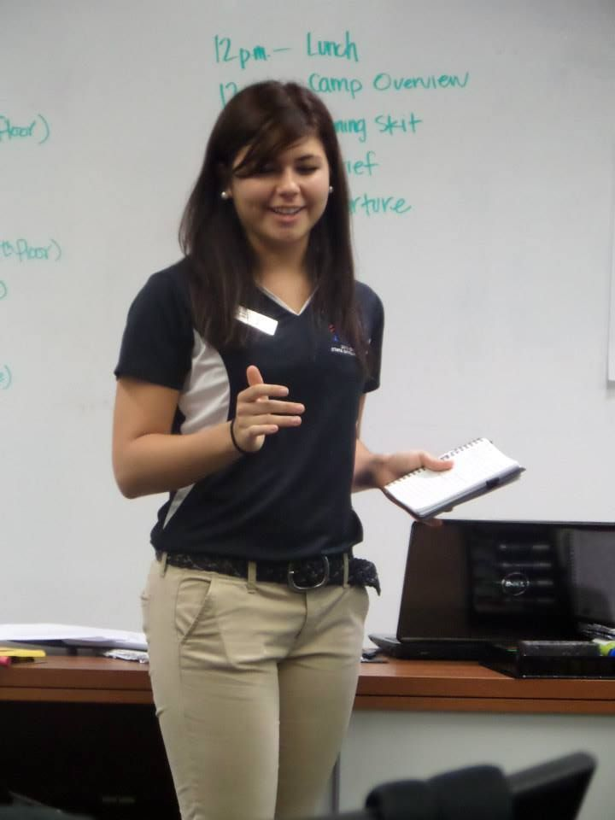
Program of Work
Calendar of Events
  Well-defined goals with steps to achieve those goals
  Officers are assigned to
  different tasks
Notes:
Successful FBLA chapters prepare a Program of Work which, in simple terms, is a calendar of activities that details who is responsible for what project. Your officers generally work on this as part of their leadership training.
Help them set long and short term goals for projects that the committees will work on, such as planning a new member induction ceremony or a project for the March of Dimes. Give each task a date for completion and assign an officer or committee chair to oversee it. You can and will modify these dates as the year progresses.
Check with each officer or committee chair regularly to determine the status of the different projects, and once they have been completed, make sure that you and your officers evaluate the project. Was it a success? What might have been done differently?
Tip: Model your Program of Work after your state’s Program of Work

Slide 18
Chapter Management 101:
Basic Steps for Running an Outstanding Chapter

