Slide 1
NEW ADVISER TRAINING
Colorado FBLA
www.coloradofbla.org
Future Business Leaders of America
August 2023

Slide 2
2
Introductions
Future Business Leaders of America

Slide 3
3
WHAT IS FBLA?
CTSO—Career and Technical Student Organization
Colorado has 8 CTSOs total
Not all 8 are offered at every school
FBLA stands for Future Business Leaders of America
Co-curricular = activities built into classroom instruction
Students can apply what they’re learning through competitive events and leadership opportunities
Future Business Leaders of America

Slide 4
4
Management Structure
Future Business Leaders of America

Slide 5
5
MANAGEMENT STRUCTURE
National Center
(National FBLA)
National FBLA plans national conferences, updates competitive events, manages membership programs for MS, HS, Collegiate
State Association
(Colorado FBLA)
Colorado FBLA plans state conferences, promotes competitive events, provides customer service to local chapters
Future Business Leaders of America
Local Chapter
(Your School)
Advisers at the chapter level manage their school’s FBLA chapter, work with other schools in your district. Make your chapter as student-led as possible.

Slide 6
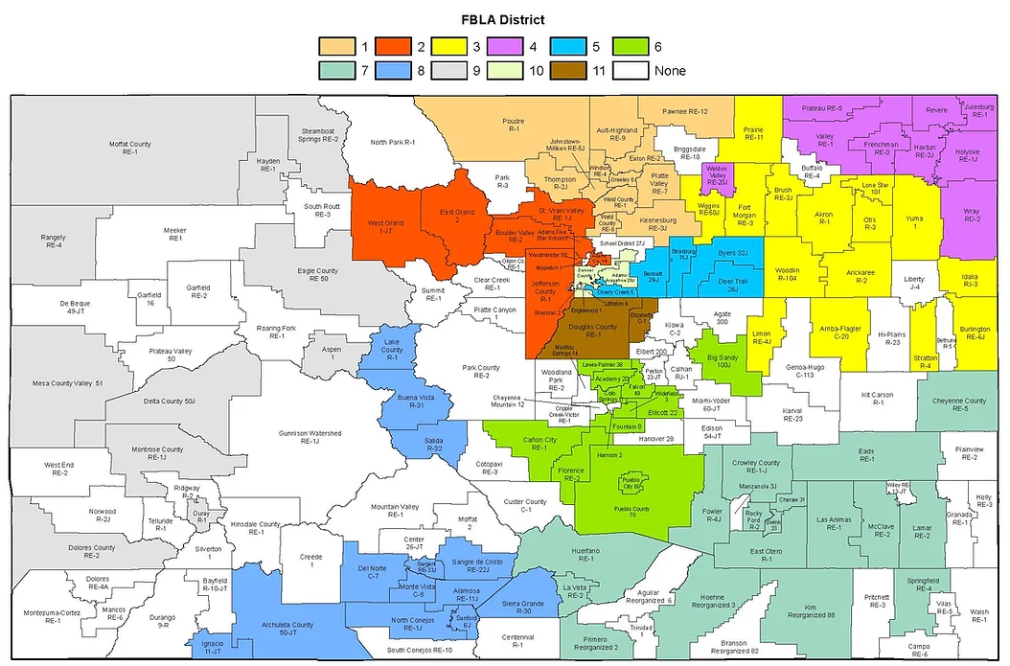
6
COLORADO FBLA
Currently 11 districts
Each district has a local conference for students to qualify to attend the state conference
https://www.coloradofbla.org/dlc
Future Business Leaders of America

Slide 7
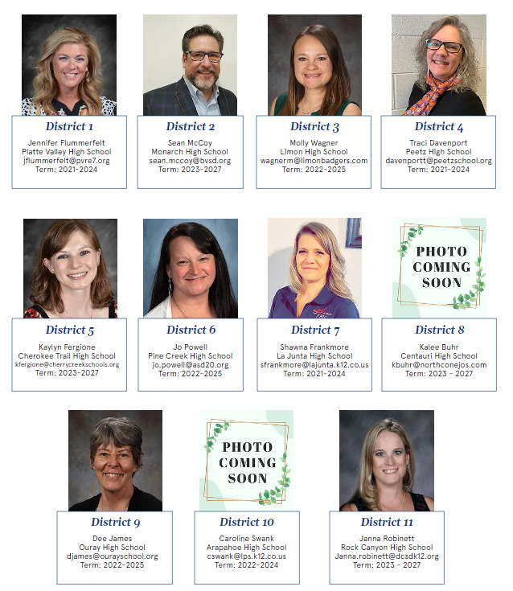
7
DISTRICT ADVISERS
Plan the District Conference
Great resource for questions!
https://www.coloradofbla.org/fbla-board-of-directors
Future Business Leaders of America

Slide 8
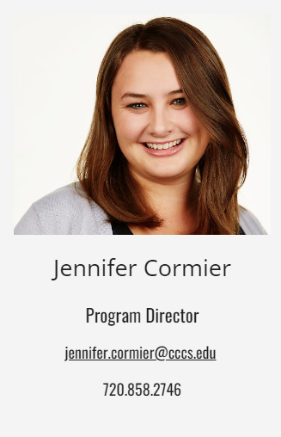
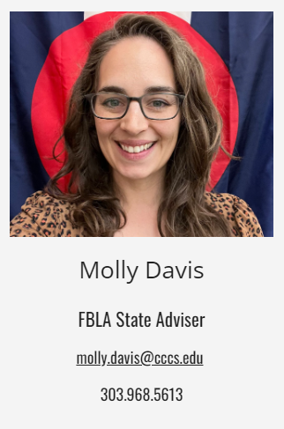
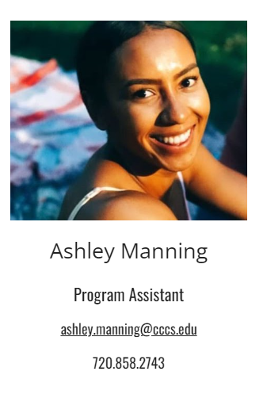
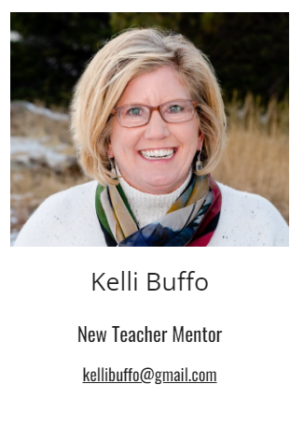
8
STATE CONTACTS
Future Business Leaders of America

Slide 9
9
FBLA Membership
Future Business Leaders of America

Slide 10
10
REGISTERING MEMBERS
Brand new database – FBLA Connect
connect.fbla.org
How To Guides posted at https://www.coloradofbla.org/adviser-resources on the All Divisions page
Future Business Leaders of America

Slide 11
11
Membership Dues
Dues are sent in one check to National FBLA
Deadline is December 1st to participate in the District Leadership Conference (DLC)
 | Middle School | High School | Collegiate
Dues Rate | $15 | $20 | $20
 | $10 to National $5 to Colorado | $10 to National $10 to Colorado | $10 to National $10 to Colorado
Future Business Leaders of America

Slide 12
12
Chapter Management
Future Business Leaders of America

Slide 13
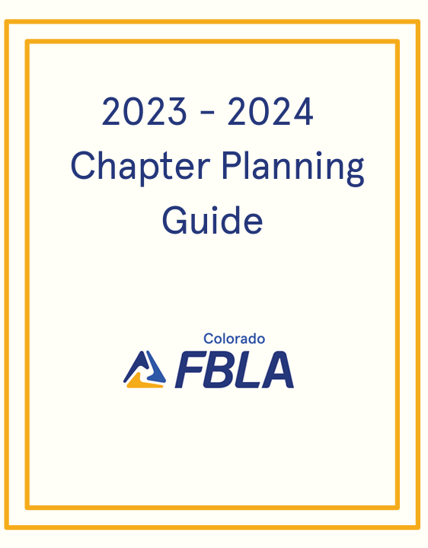
13
CHAPTER MANAGEMENT
Chapter Planning Guide
Best tool to navigate throughout the year and utilize when building Program of Work
https://www.coloradofbla.org/adviser-resources
Host regular meetings or have scheduled FBLA days in class to keep engagement and involvement high
Get an officer team and encourage them to plan and lead meetings
Future Business Leaders of America

Slide 14
14
Conferences
Future Business Leaders of America

Slide 15
15
CONFERENCES
 | Colorado Fall Leadership Conference | National Fall Leadership Conference
Date | October 20 (Denver) | November 10-11 (Providence) November 17-18 (Dallas)
Division | All three divisions | HS & MS
Brief | Leadership workshops lead by State Officers | Leadership workshops and chapter planning in two National locations
Future Business Leaders of America

Slide 16
16
CONFERENCES
 | District Leadership Conference | State Leadership Conference (MS) | State Leadership Conference (HS) | National Leadership Conference
Date | January/February (Various Locations) | March 13, 2024 (Brighton) | April 1-3, 2024 (Aurora) | June 29-July 2, 2024 Orlando, FL
Division | High School | Middle School | High School | HS & MS
Brief | First round of competitive events with leadership workshops | Competitive events with leadership training | State competitive events, leadership workshops, exhibitor fair, massive general session and officer selections | National School competitive events, business tours, exhibitors, general sessions and officer elections
Future Business Leaders of America

Slide 17
17
Competitive Events
Future Business Leaders of America

Slide 18
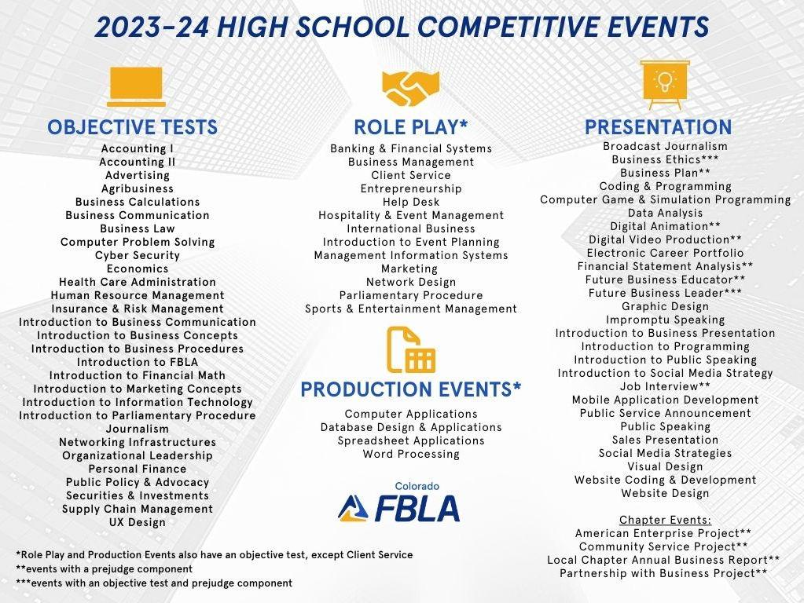
18
COMPETITIVE EVENTS
Guidelines for each division will be coming from Nationals and posted to our website
https://www.coloradofbla.org/competitions
Future Business Leaders of America

Slide 19
19
COMPETITIVE EVENTS CATEGORIES
Objective Test
Online test typically of 100 questions
Production Test
Two parts: production test & objective test
Presentation Event
Project, speech, or interview
Case Study/Role Play Event
Two parts: objective test and interactive role play
Future Business Leaders of America

Slide 20
20
Educational Programs
Future Business Leaders of America

Slide 21
21
EDUCATIONAL PROGRAMS
Variety of programs to integrate into the classroom – learn more about these if you have the capacity during your first year. If not, integrate them into your 2nd year as an adviser.
Business Achievement Awards (HS)
LEAD Awards (MS)
Champion Chapter (HS)
Peak Awards (Colorado)
LifeSmarts
Lead4Change
The Stock Market Game
Intuit Social Innovation Challenge
Virtual Business Challenge
Future Business Leaders of America

Slide 22
22
Communication
Future Business Leaders of America

Slide 23
23
COMMUNICATION
Weekly Email from Molly/Colorado FBLA
Questions?
Reach out to your District Board Representative
Utilize Kelli for general CTSO and classroom questions
Check out the Colorado FBLA website
Email Molly Davis
Future Business Leaders of America

Slide 24
THANK YOU!
Questions? Contact Molly Davis, molly.davis@cccs.edu
Future Business Leaders of America
AUGUST 2023

