Slide 1
FBLA

Slide 2
What is FBLA?
Future Business Leaders of America
It is an organization that prepares today’s students for success in business and computer science leadership through:
Leadership
Community Service
Competitions

Slide 3
Reminders
To get reminders you can check:
Announcements
Moodle
FBLA Bulletin Boards
Remind 101
sign up for text reminders

Slide 4
Recruitment Awards
Recruiting Contest:
Member with the highest number of recruits by October 31st will receive a $10.00 I-tunes Gift Card

Slide 5
Membership Sign-ups
FBLA Dues :
$15 (without t-shirt)
$25 ( with t-shirt; indicate t-shirt size on membership form)
MAKE ALL CHECKS PAYABLE TO

Slide 6
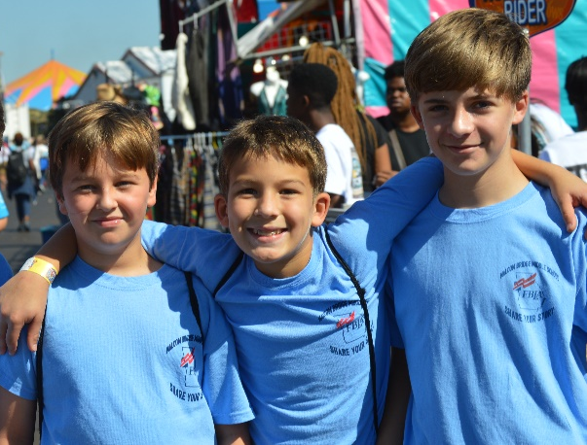
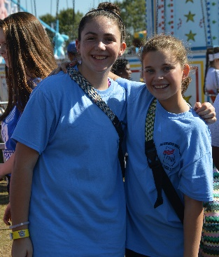
FBLA Leadership Team
President –
Vice Presidents:
8th Grade VP Community/School Service –8th Grade VP Publicity–
8th Grade VP Chapter Management–
8th Grade VP Special Events –
8th Grade VP Conference/Competitive Events –
7th Grade VP Chapter Management–
7th Grade Representatives –

Slide 7
Ice Cream Social Sign-Up
September 1st
3:30 – 4:30
Sign-up on the sign-up sheet provided
Remember: Must be paid member to attend

Slide 8
Upcoming Events

