Slide 1
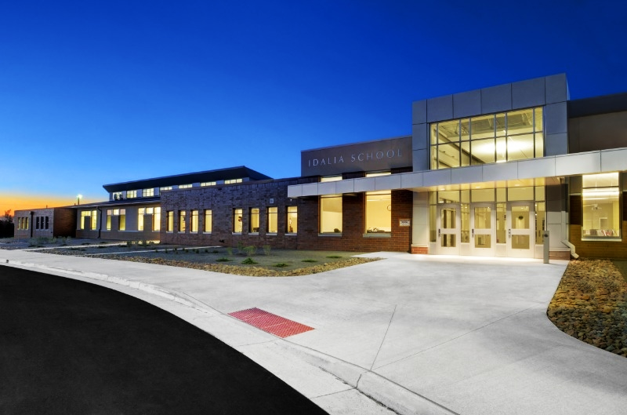
Wolfpack Study Buddies
FBLA Capstone
2023 Sample Project

Slide 2
Overview
Tutoring program at the Idalia Elementary School
Idalia High School students tutored elementary students
Served as in-class one-on-one buddies

Slide 3
The Why
Problem Statement
Empathy and Inspiration
Stakeholders
Causes and Effects
Create a tutoring program
Team of fun and helpful tutors
Help struggling elementary students
Practice skills and build better mindsets
1-on-1 time
Teacher Relief
Reviewing skills
Good mindsets
COVID-19
Online Learning
New Curriculum
Below benchmark students
Frustrated classroom environment
Elementary Students
Grades 1-5
Idalia Community
School Staff

Slide 4
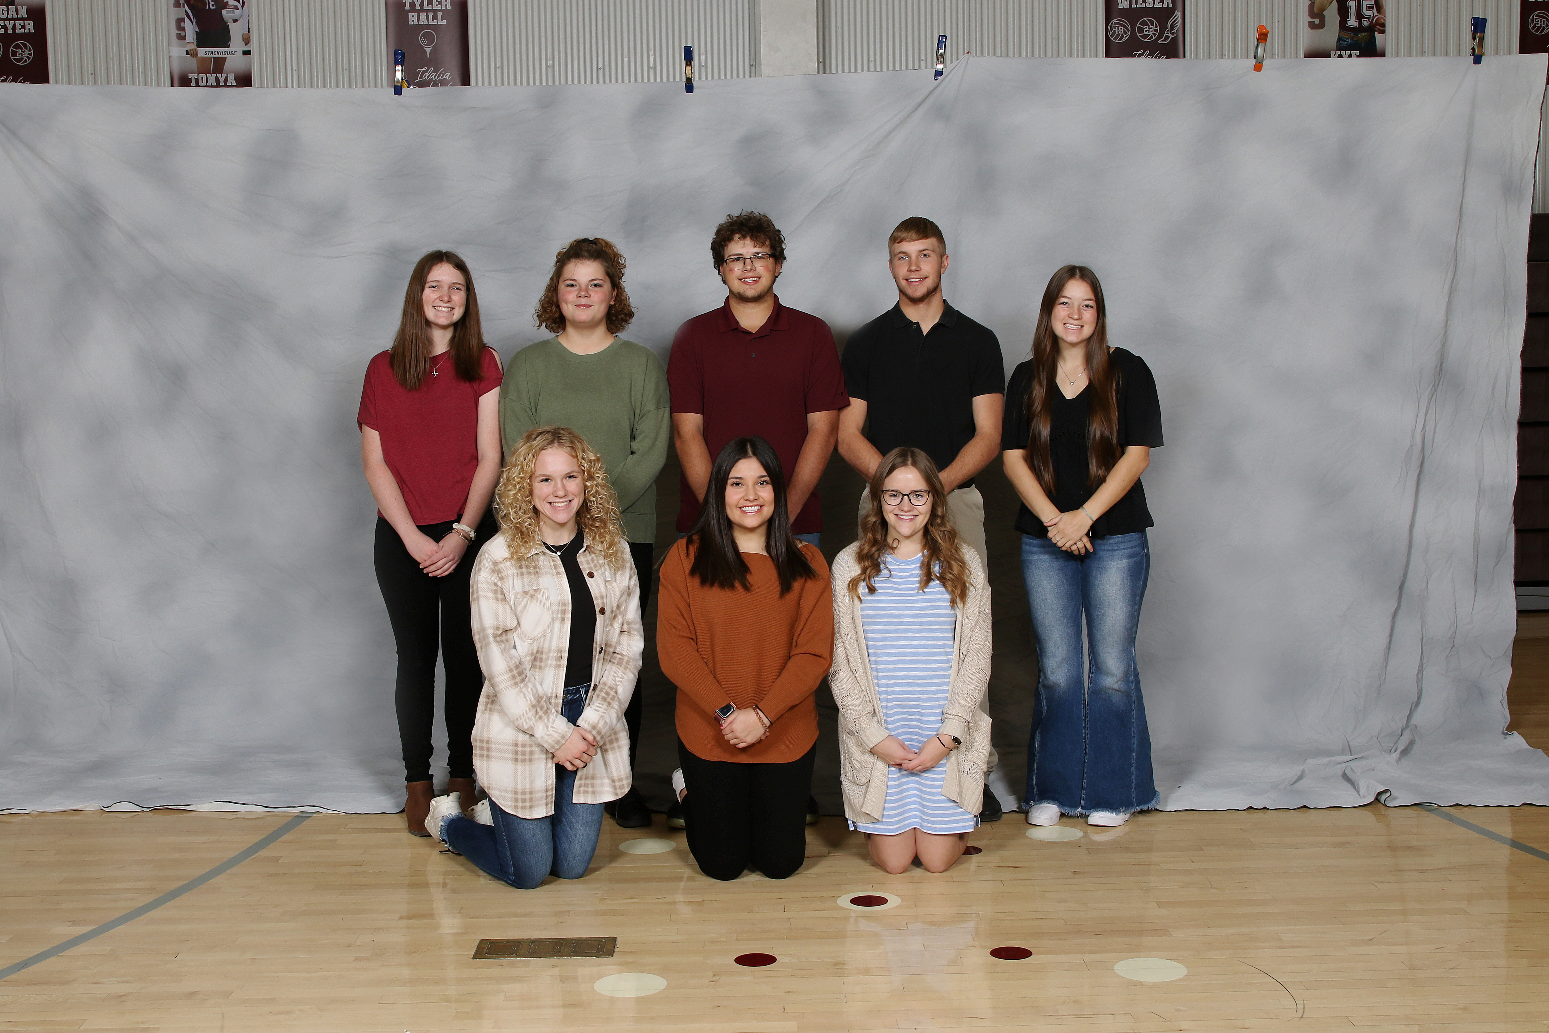
The Solution
A tutoring program
High school tutors and mentors
Relieve teacher stress
Improve knowledge and attitudes of students
Goals
Tutor 15 students
5 scholarly tutors

Slide 5
Project Plan
Budget
Milestones
Original after-school tutoring
Snacks
$30
Reformed in-school tutoring
$0
No fundraising took place
Obtain admin and parent permission
Apply tentative schedule to Week 1
Complete Week 1 with and make revisions
Complete the spring semester
Fun day with students

Slide 6
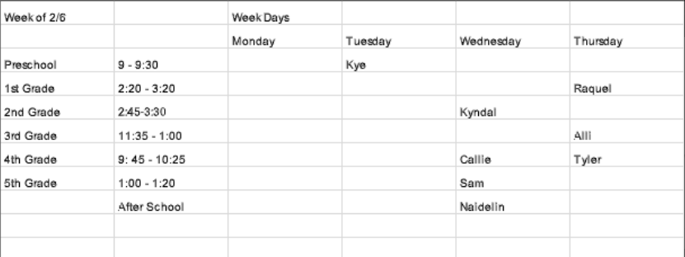
Team Management
Team included:
My mentor
NHS Coordinator
9 NHS Members
Organized by spreadsheet schedule
06
JULY

Slide 7
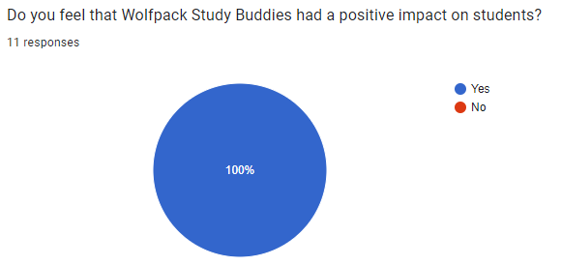
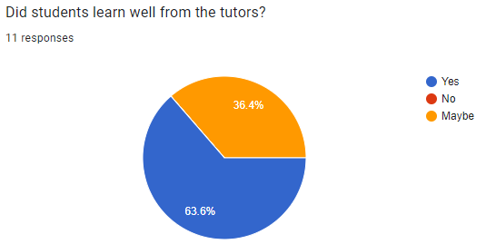
Quantitative Impact

Slide 8
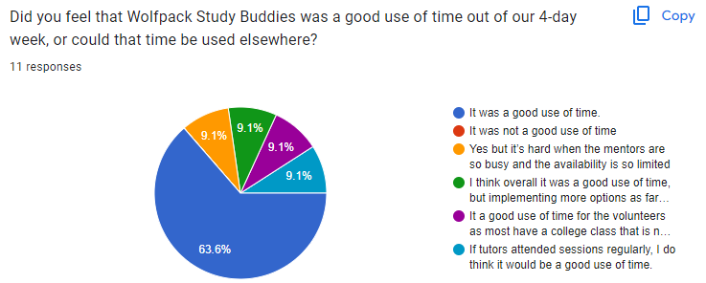
Quantitative Impact
Tutored 17 kids
Team of 9 tutors
12 weeks of tutoring

Slide 9
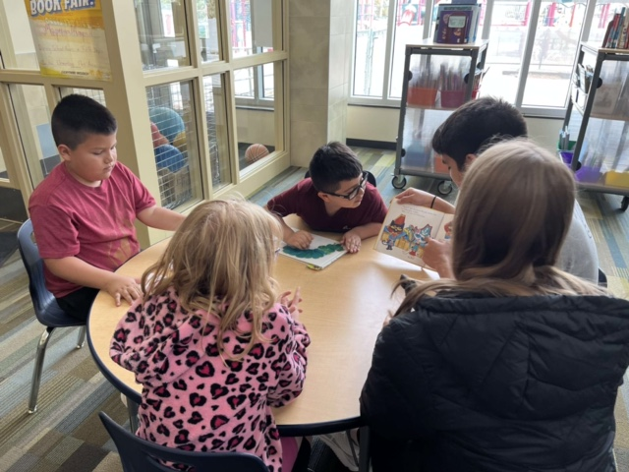
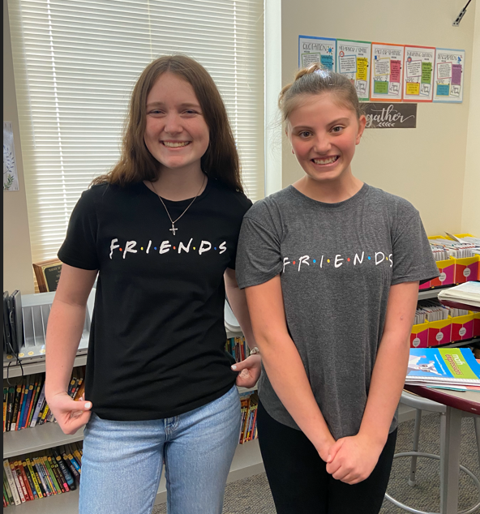
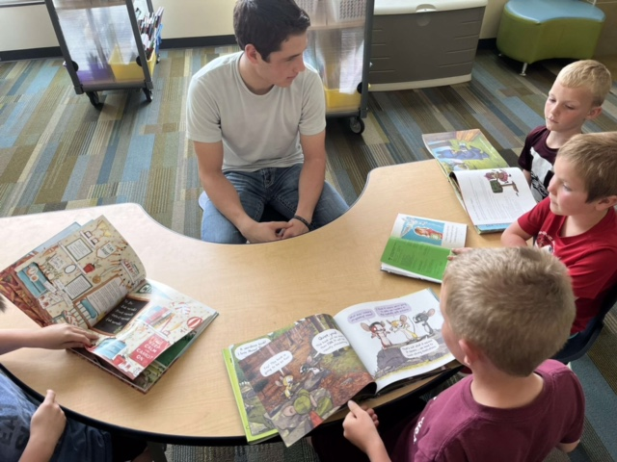
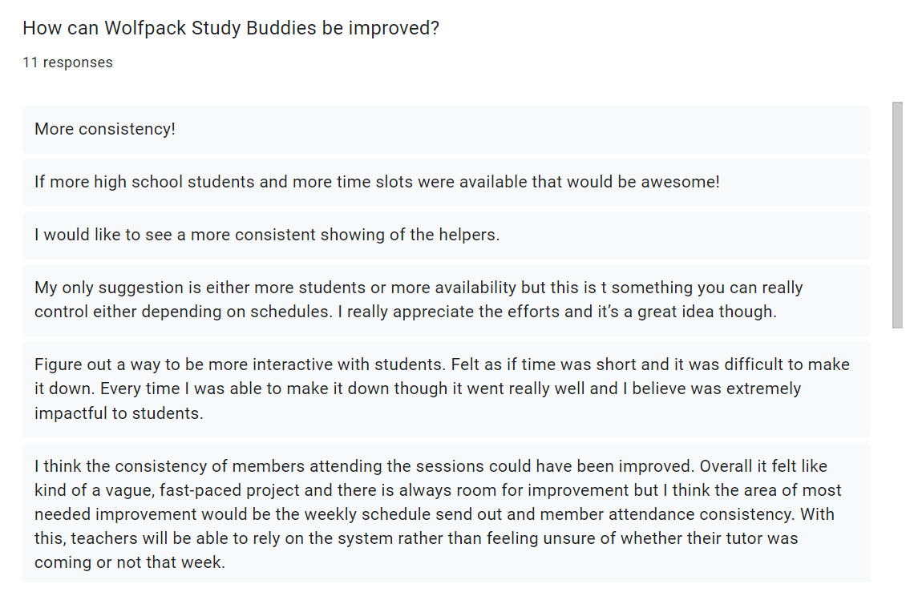
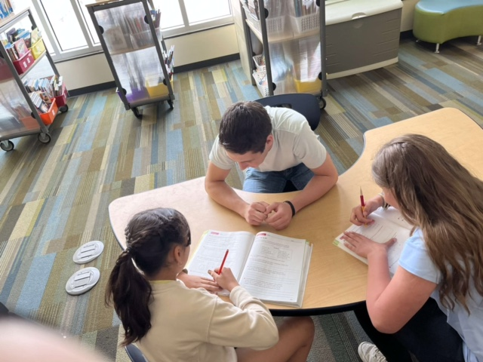
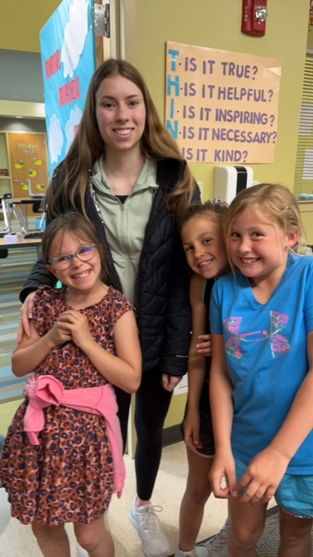
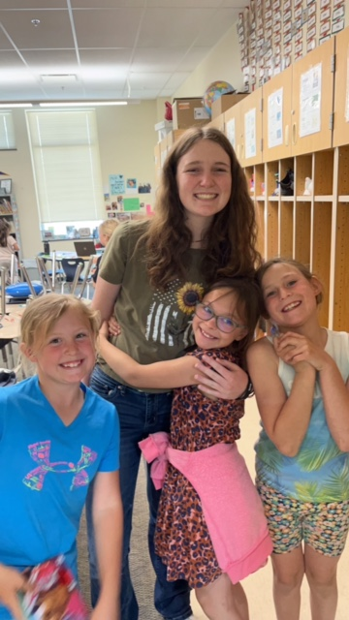
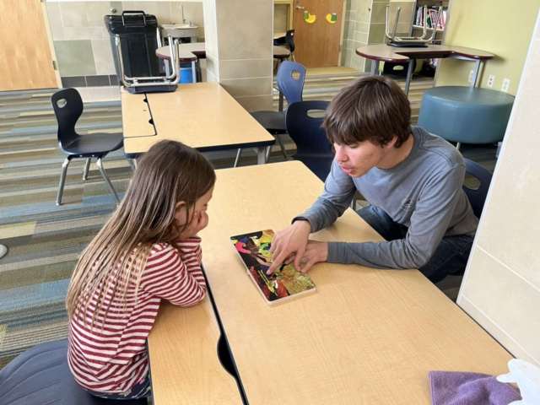
Qualitative Impact

Slide 10
Lessons Learned
Scheduling tutoring times
Matching tutor schedules to elementary schedules
Start earlier in the school year
Allow time in project schedule for roadblocks

Slide 11
Personal and Community Growth
Personal
Communication skills
Coordinating with teachers, tutors, and mentors
Time-management skills
Meeting deadlines efficiently
Community
Improved school connections
Relieved teacher stress
Improved mindsets
Brought back our small community spirit

Slide 12
Wolfpack Study Buddies
FBLA Capstone
2023 Sample Project

