Slide 1
LET’S CELEBRATE AMERICAN ENTERPRISE!
Notes:
Welcome to the Let’s Celebrate American Enterprise presentation!

Slide 2
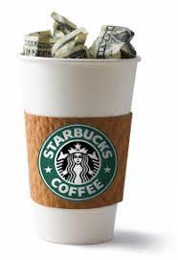
What Is Free Enterprise?
It is the freedom of private business to organize and operate for profit in a competitive system without interference by government except for regulation which is necessary to protect public interest and keep the national economy in balance.
Notes:
WHAT IS FREE ENTERPRISE?
The slide states that Free Enterprise is the freedom of private business to organize and operate for profit in a competitive system without interference by government except for regulation which is necessary to protect public interest and keep the national economy in balance.
So what does that mean ? It means the government lets businesses operate and compete for YOUR money. This also means the Government does not interfere except for making sure that business are following the laws.
Free Enterprise is also known as free market or capitalism.

Slide 3
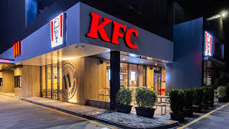
What Is An Example of Free Enterprise?
Notes:
An example of free enterprise is a restaurant. You can decide if you want Chick-Fil-A or Kentucky Fried Chicken. They both know you their customers have options, so this motivates businesses to make the best product offered at the best price, and hopefully the best customer service – all for you the customer.
.

Slide 4
Why Does American Enterprise Matter?
We have options in the market
We can make individual choices through the price system.
It creates competition, resulting in lower prices, more variety, and higher-quality goods.
v.s.
Notes:
As a result of a free enterprise system, we have options in the market and can make individual choices through the price system. American free enterprise creates competition, resulting in lower prices, more variety, and higher-quality goods.
Free Enterprise occurs in daily life!
You have choices: What will you have for lunch? What movie or TV show will you watch? What app will you download? What club will you join?
Business are always competing for you.
When applying for colleges, you have to stay competitive, just like businesses!

Slide 5
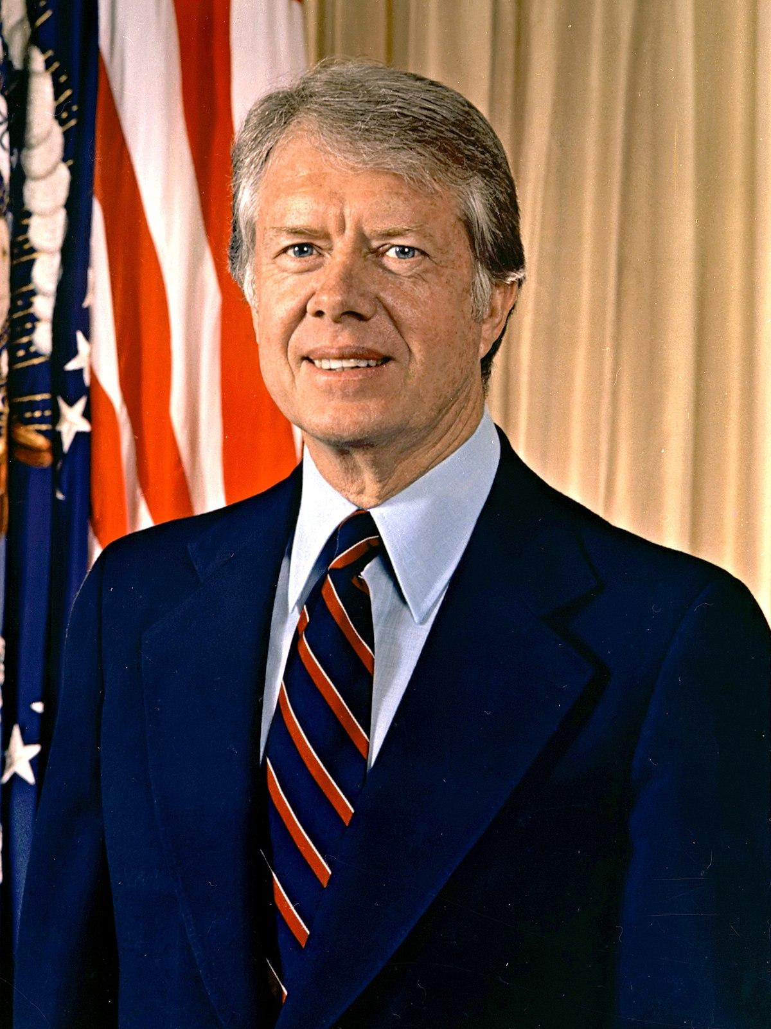
History of American Enterprise Day
Jimmy Carter
39th President
of the United States
American Enterprise Day began with a proclamation from President Jimmy Carter in the 1970s.
The U.S. economy is a free enterprise system.
Thanks to the free enterprise system, you as a customer have choices.
Notes:
Because Free Enterprise is so important, the 39th President of the United States, Jimmy Carter, proclaimed November 15 as American Enterprise Day.
Thanks to the free enterprise system, you as a customer have choices. That’s a lot to celebrate!

Slide 6
What Can FBLA Do About American Enterprise Day?
YOUR LOGO
Salute and publicize the American free enterprise system
Be a Leader and Educate Others
Chapters celebrate through activities, projects, and festivities.
Notes:
So what can our chapter do about American Enterprise Day?
We can Salute and publicize the American free enterprise system
We can Be Leaders and Educate Others
We can join ither FBLA Chapters celebrate through activities, projects, and festivities.

Slide 7
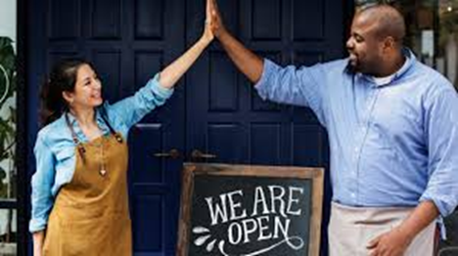
How can my chapter celebrate American Enterprise Day?
Business Tour
Schedule a business tour of a local business or larger company (and support them!)
Notes:
We will now review five possible ways to celebrate American Enterprise Day.
We can Schedule a business tour of a local business or larger company (and support them!) Does anyone have a parent or no someone who owns a company or business that we can tour?

Slide 8
How can my chapter celebrate American Enterprise Day?
Guest Speaker
Ask a working parent or business owner to be a guest speaker at a local chapter meeting
Notes:
WE can have a Guest Speaker come talk to us about any topic – why does the free enterprise mean to them? What advice can they give us?
Does anyone have a working parent or know a business owner that can be a guest speaker at one of our chapter meetings?

Slide 9
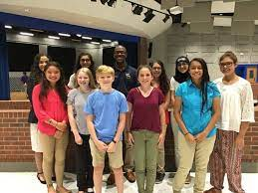
How can my chapter celebrate American Enterprise Day?
Educate & Be A Leader
Do a Meet & Greet with your Middle School and present a skit on the importance of free enterprise system and how it affects the job market. Motivate them to join FBLA in High School!
Notes:
We Can Educate Others on the Importance of American Enterprise Day!
One possible activity is to do a Meet & Greet with our Middle School and present a skit on the importance of free enterprise system and how it affects the job market. We can also us e that opportunity to motivate them to join FBLA in High School!

Slide 10
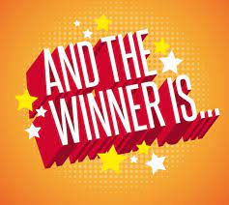
How can my chapter celebrate American Enterprise Day?
Create An Essay Contest
Ask the school newspaper (or website) editor if they could judge and publish the winning article, and then host an essay contest and ask members (or open it to the entire school) to write about the American enterprise system. Get 100% chapter participation in the contest!
Notes:
As FBLA members, we love competitions! We can create a contest. For example, we can Create An Essay Contest and ask the school newspaper (or website) editor if they could judge and publish the winning article, and then host an essay contest and ask members (or open it to the entire school) to write about the American enterprise system. The most important thing is to get 100% chapter participation in the contest!

Slide 11
LET’S CELEBRATE AMERICAN ENTERPRISE!
Notes:
Let’s now discuss and decide what activity our chapter would like to do to celebrate American Enterprise Day.

